Slide 1
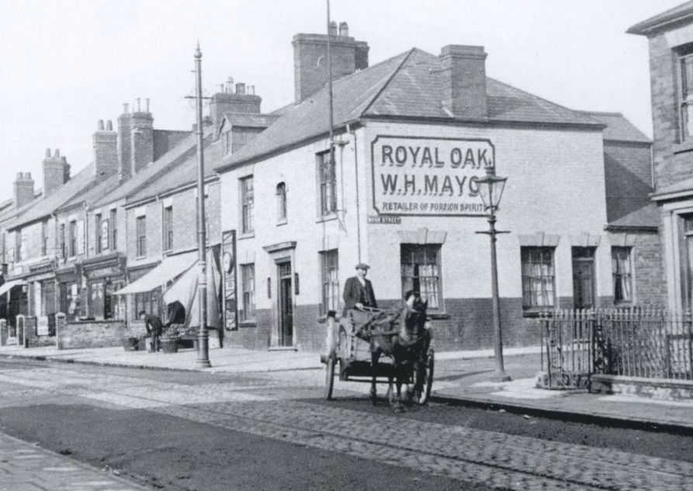

Uncovering Earlsdon’s Origins & Growth
David Porter & John Purcell
Earlsdon Research Group

Slide 2
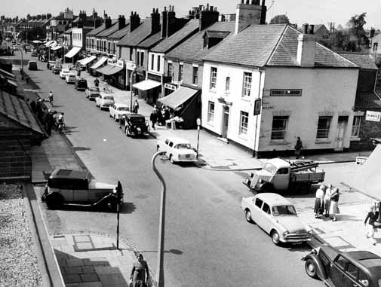
In uncovering Earlsdon’s origins and growth, the following presentation draws upon original research into the census returns for 1861, 1891 and 1921, with additional material to provide context for these findings.
Earlsdon Street in the 1950s

Slide 3
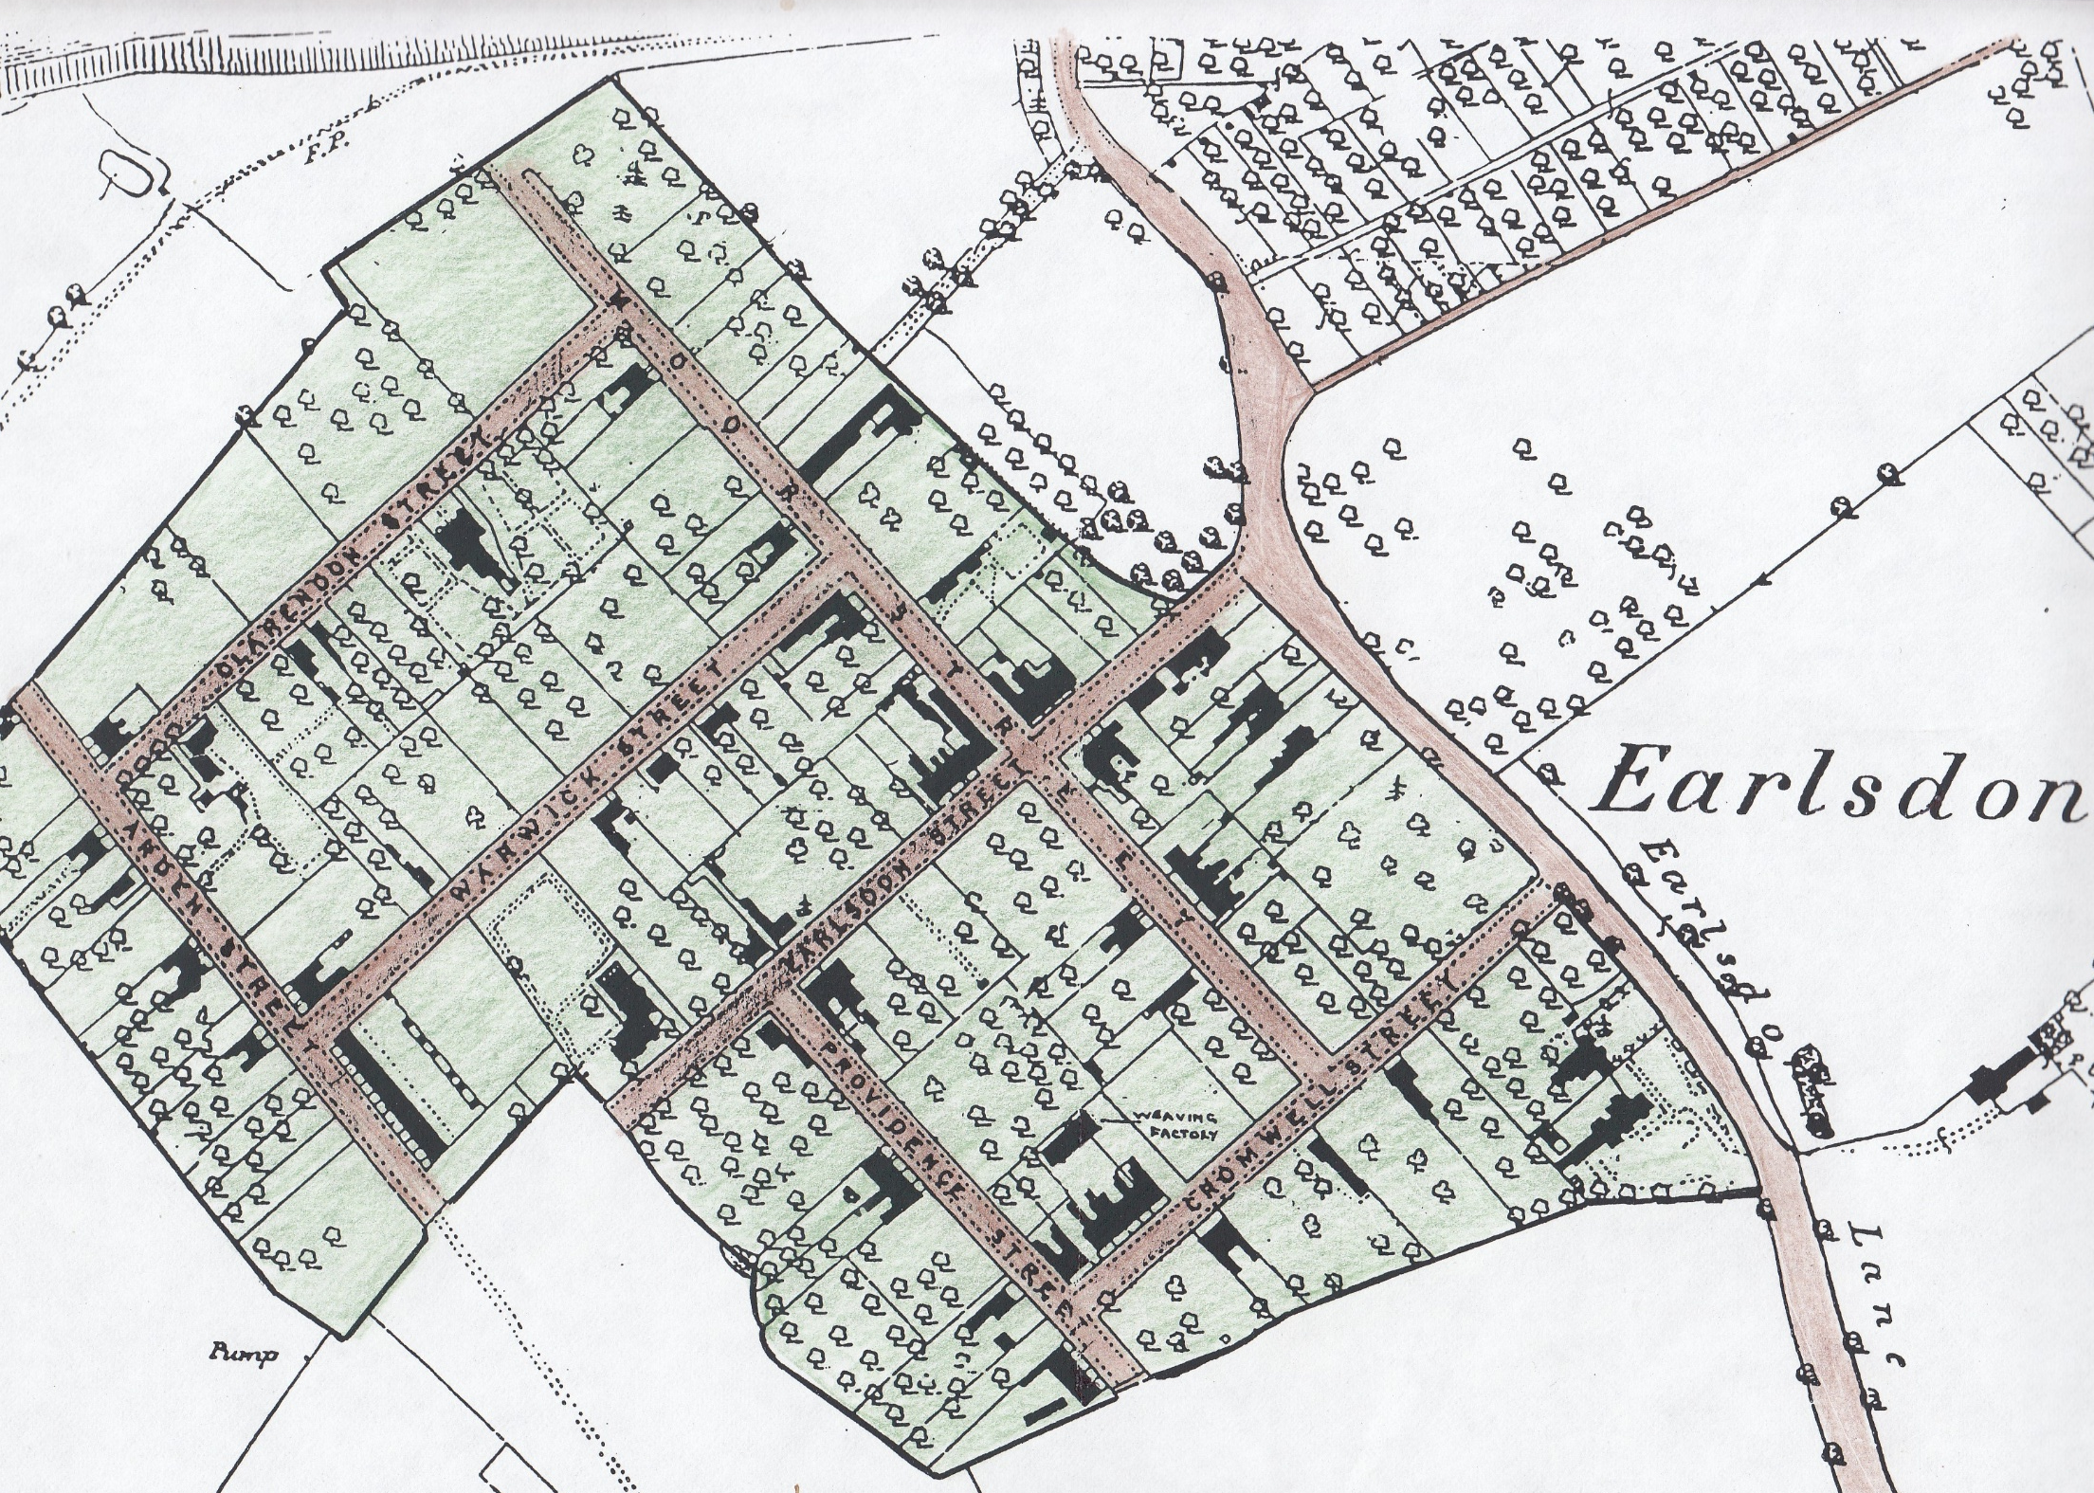
The Earlsdon estate 1861 with 105 houses – from the original 6 fields divided into 8 streets in 1852

Slide 4
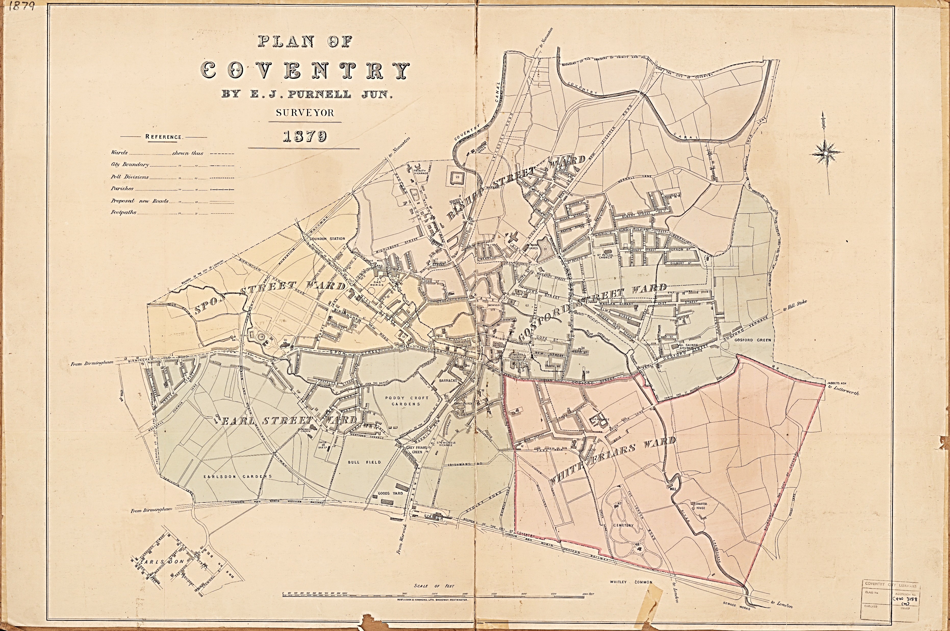
Map of Coventry 1879
By E J Purnell Jnr

Slide 5
Population growth on the eight streets compared with Coventry and England & Wales 1861, 1891 & 1921*
Earlsdon Population |  |  |  | Coventry Population |  |  |  | England & Wales Population
1861 |  | 493 |  | 1861 |  | 40936 |  | 1861 |  | 20066224
1891 |  | 727 |  | 1891 |  | 52742 |  | 1891 |  | 29002525
1921 |  | 1489 |  | 1921 |  | 128157 |  | 1921 |  | 37886699
increase 1861—1891 |  | 234 |  | increase 1861--1891 |  | 11806 |  | increase 1861--1891 |  | 8936301
percentage increase |  | 47% |  | percentage increase |  | 29% |  | percentage increase |  | 45%
increase 1891—1921 |  | 762 |  | increase 1891--1921 |  | 75415 |  | increase 1891--1921 |  | 8884174
percentage increase |  | 105% |  | percentage increase |  | 143% |  | percentage increase |  | 31%
* Throughout this document, please note that all figures presented here refer only to the original eight streets on the Earlsdon estate

Slide 6
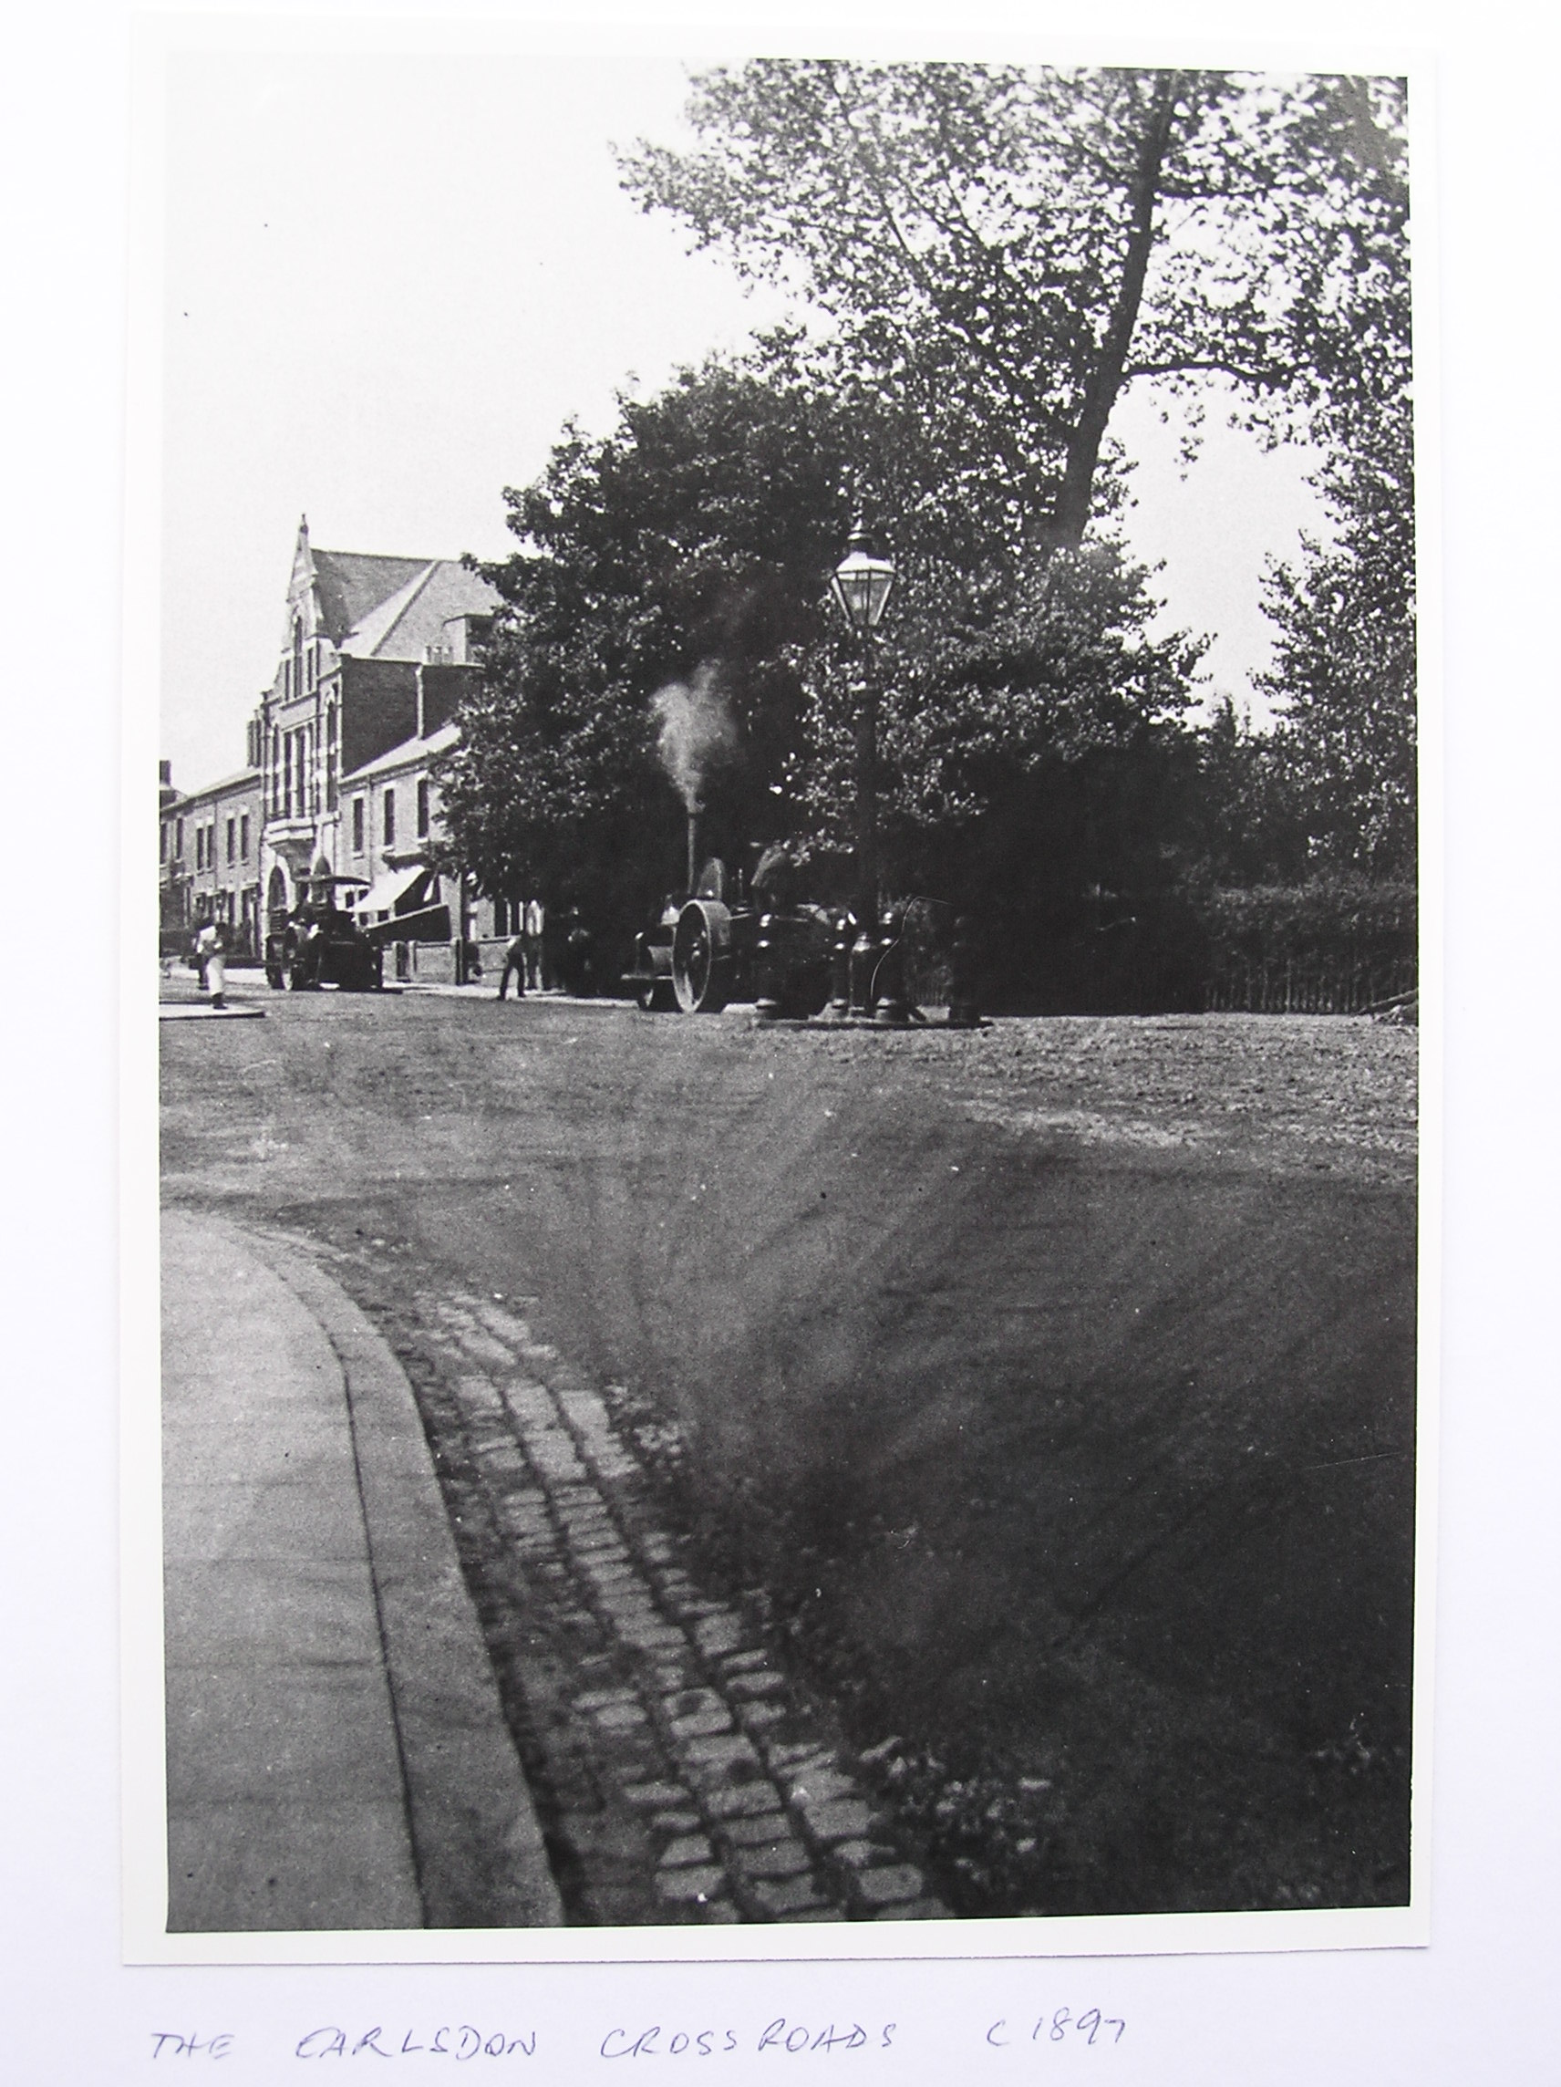
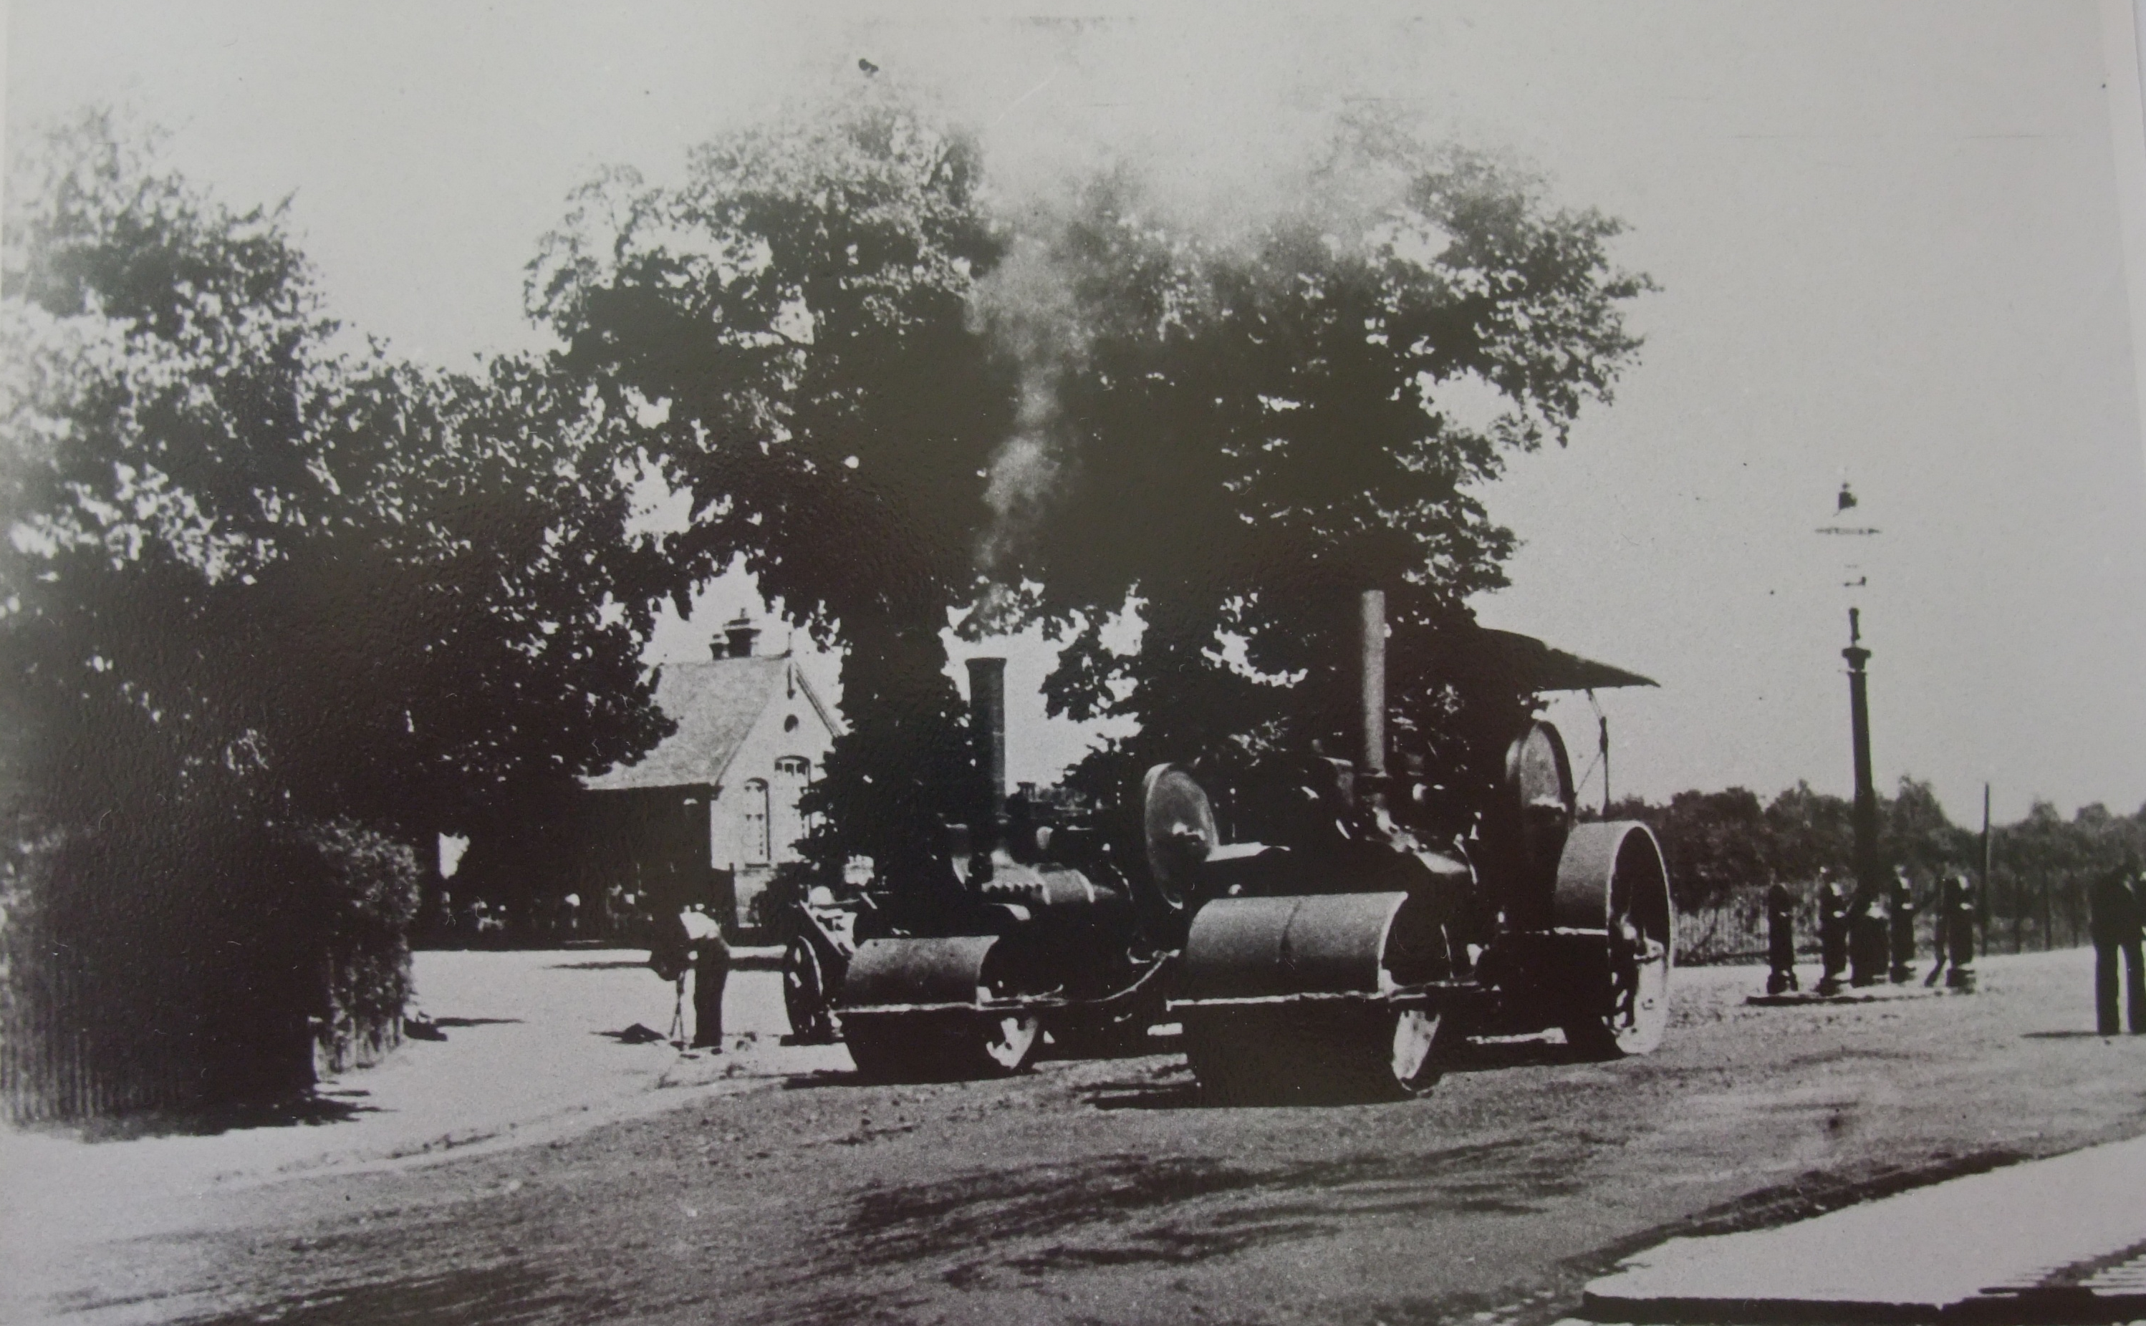
The construction of Albany Road in 1898 linking Earlsdon to the city of Coventry – a major factor in Earlsdon’s growth
“There is no finer site within easy reach of the centre of the City.”
Coventry Graphic 17th August 1912

Slide 7
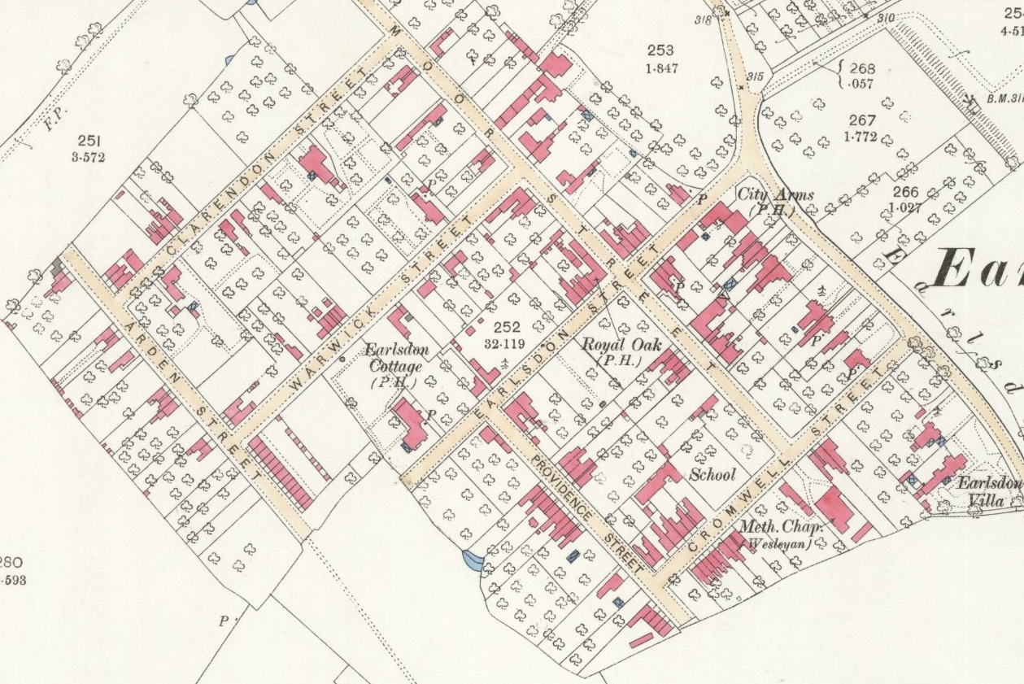
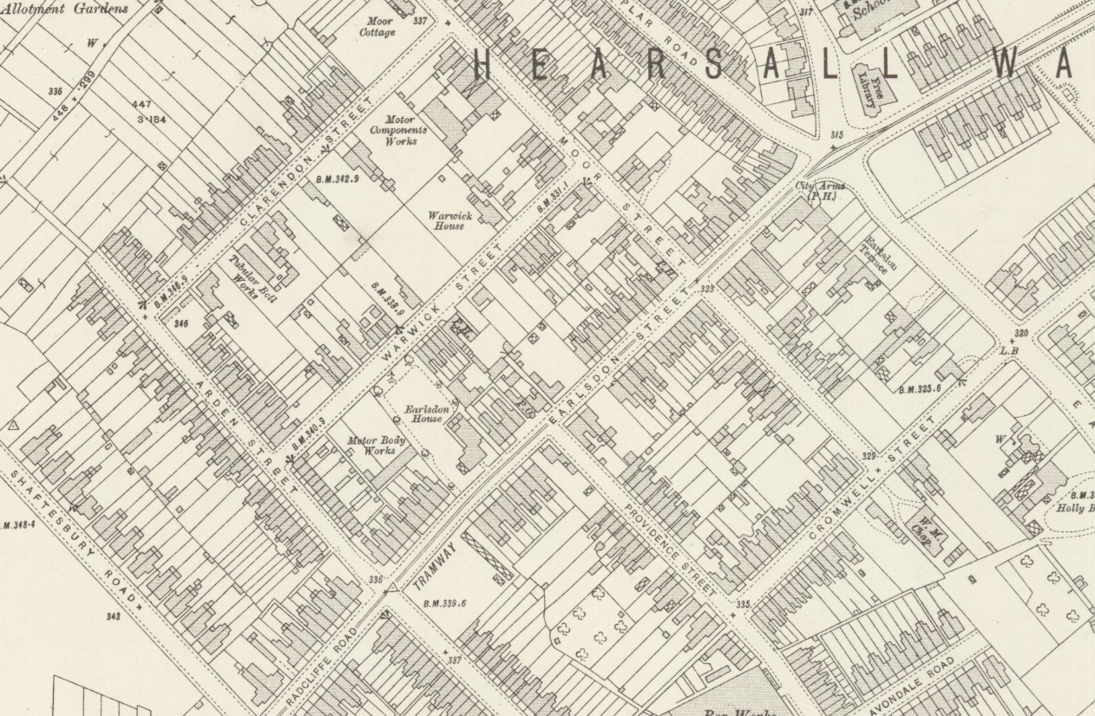
Earlsdon in 1886
Earlsdon in 1913
The 1891 Census recorded 152 houses …
… while the 1891 Census recorded 353 houses

Slide 10
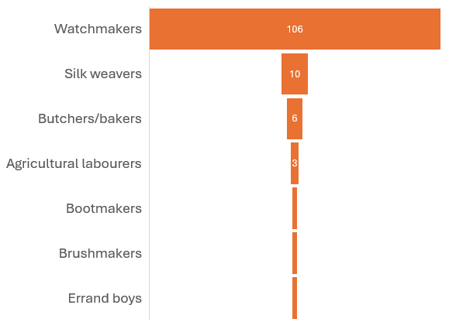
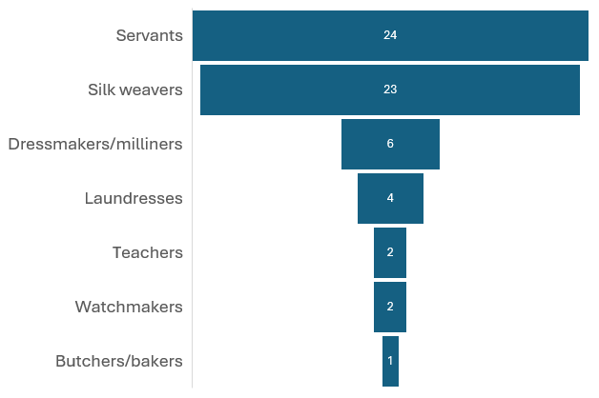
Male Occupations in Earlsdon in 1861
Female Occupations in Earlsdon in 1861

Slide 11
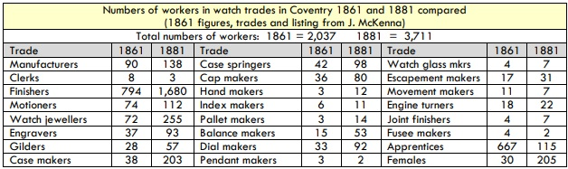
From: Thomas, Darlah (March 2019) A Snapshot of the Watchmaking Industry in England through the Lens of the 1881 Census
Antiquarian Horology, 40, 1, 36-58

Slide 12
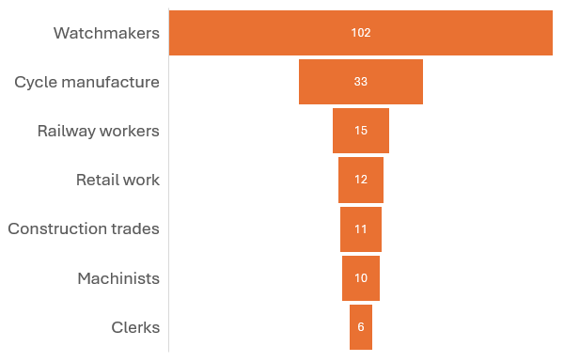
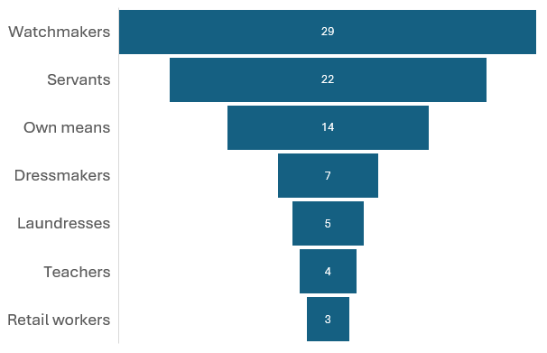
Male Occupations in Earlsdon in 1891
Female Occupations in Earlsdon in 1891

Slide 13
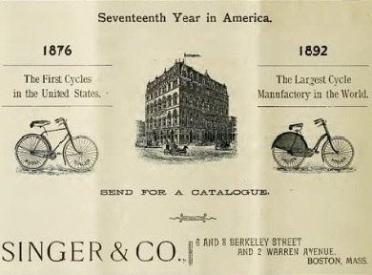
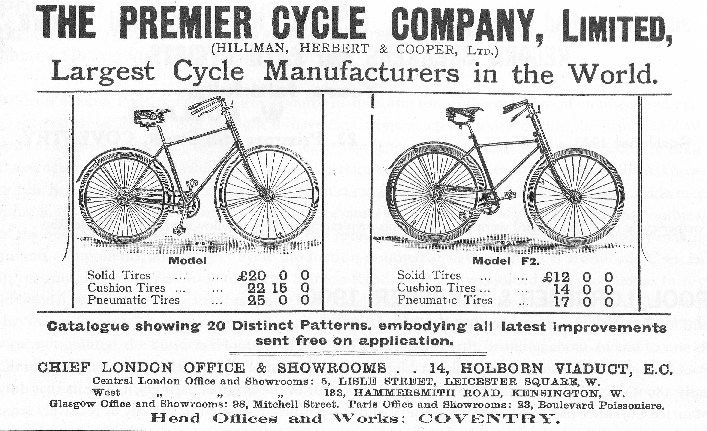
“The peak year [for cycle production] was 1896, but right until the outbreak of the Great War in 1914 Coventry remained the centre of the world’s cycle industry. In 1906, for example, the Rudge Whitworth Company alone made 75,000 machines, while the city’s total output stood at well over 300,000.”
From: Fox, Levi (1957). Coventry’s Heritage. Coventry: Coventry Evening Telegraph (2nd edition)

Slide 14
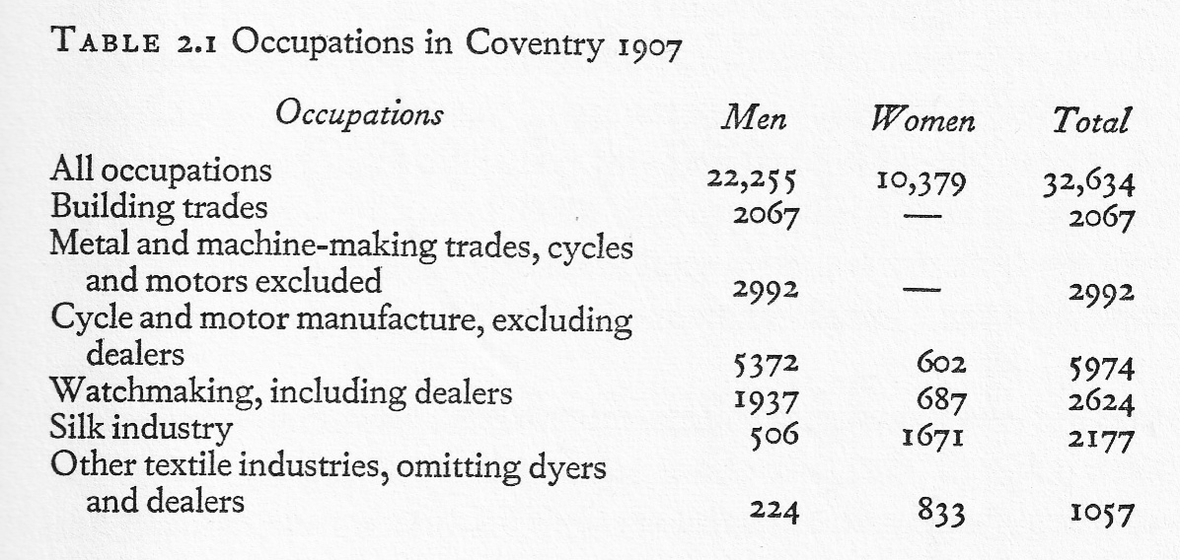
From a 1907 Economic Journal article cited in Richardson, Kenneth (1972) Twentieth Century Coventry

Slide 15

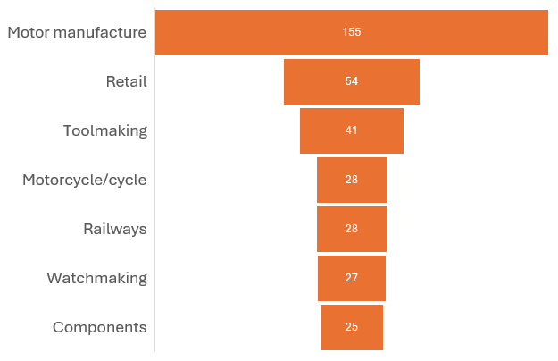
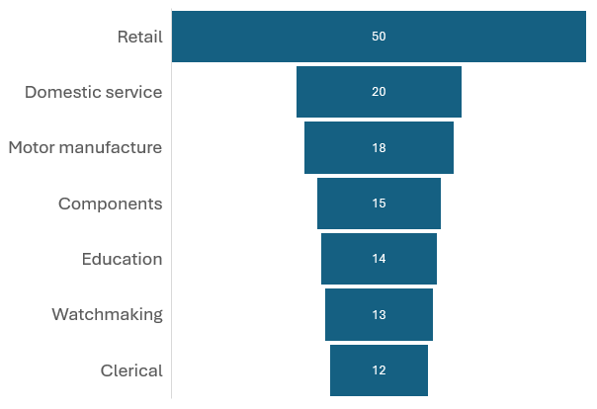
Male Occupations in Earlsdon in 1921
Female Occupations in Earlsdon in 1921

Slide 16
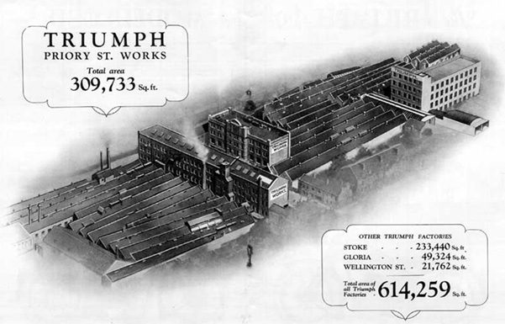
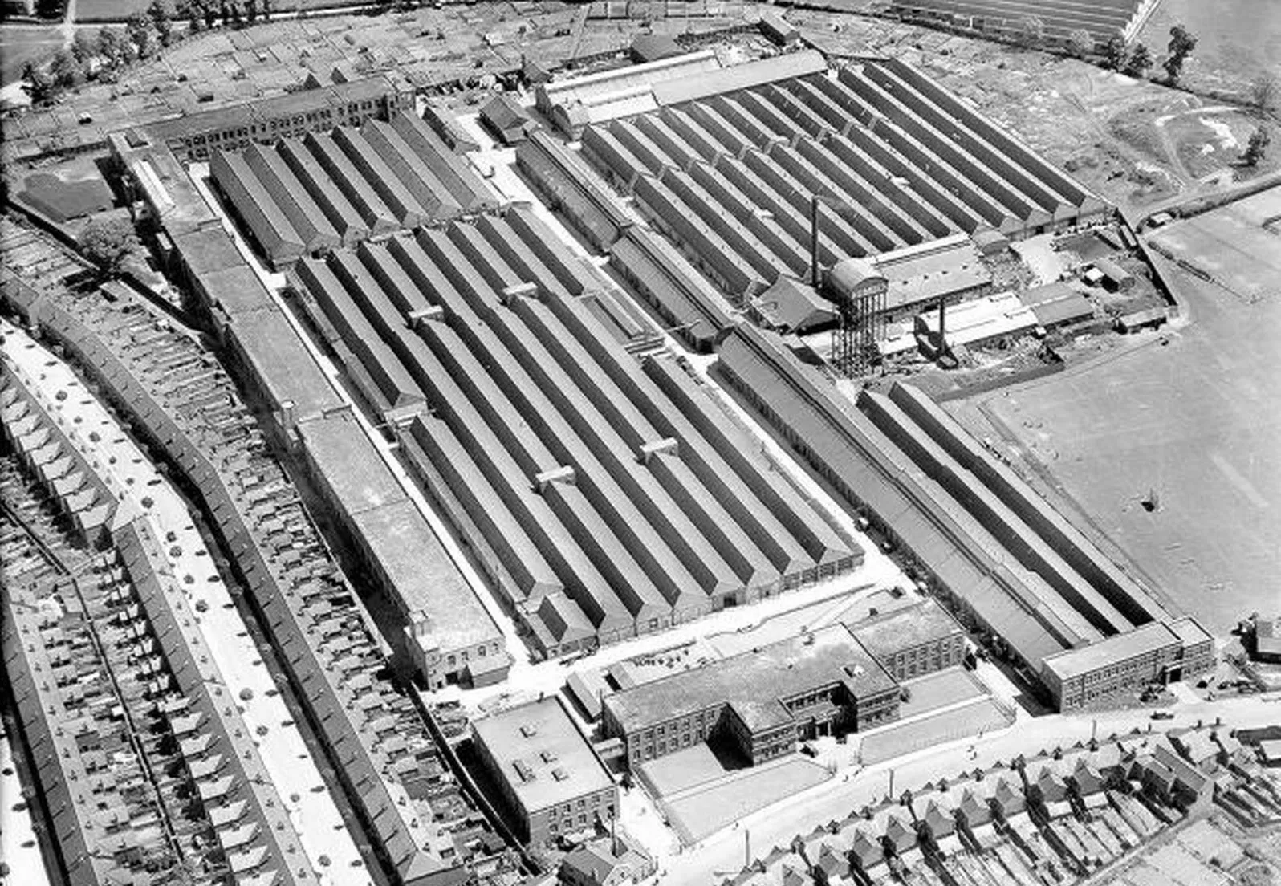
Humber factory, Stoke
“Major orders for the 550cc Model H came from the British Army during World War I and, by 1918, they were Britain's largest motorcycle maker.”
https://www.gracesguide.co.uk/Triumph_Cycle_Co
“In 1911 6,838 male workers ... were concentrated in Coventry. This compared with some 5,400 in Birmingham, 1,300 in Wolverhampton, and 2,800 in Worcestershire, Staffordshire, and Warwickshire.” https://www.british-history.ac.uk/vch/warks/vol8/pp162-189#h3-s11

Slide 17
Males/Females in Earlsdon as a Percentage of the Paid Workforce in 1861, 1891 & 1921
 | Females |  | Males |  | Total
1861 | 62 | 29% | 155 | 71% | 217
1891 | 95 | 29% | 236 | 71% | 331
1921 | 198 | 29% | 496 | 71% | 694
 |  | Females as a Percentage of the National Paid Workforce
 | 1891 |  | 1901 |  | 1911 |  | 1918 |  | 1920
 | 31% |  | 30% |  | 30% |  | 38% |  | 28%

Slide 18
Earlsdon residents’ places of employment 1921
Company |  | Total |  | Place | Laid off
Standard Motor Co |  | 39 |  | Canley (33) / Cash's Lane (5) / Widdrington Road (1) | 4
Alfred Herbert |  | 29 |  | Butts
LNWR |  | 28 |  | Station
Coventry Chain |  | 27 |  | Spon End
Rover |  | 25 |  | Garfield Rd (22) / Parkside (3) | 3
Daimler |  | 19 |  | Sandy Lane (17) / Radford (1) / Foleshill Road (1) | 9
Rudge Whitworth |  | 19 |  | Crow Lane | 1
Rotherham & Sons |  | 15 |  | Spon End | 3
Education Authority |  | 13 |  | various
Swift Motor Cars |  | 11 |  | Cheylesmore | 1
Triumph |  | 11 |  | Priory Street | 1
Williamsons |  | 10 |  | Holyhead Road | 2
Acme Motors |  | 10 |  | Osborne Road
Armstrong Siddeley |  | 9 |  | Parkside | 2
Maudslay |  | 8 |  | Parkside | 2
Co-op |  | 7 |  | various
Humber |  | 7 |  | Stoke | 1
Own account |  | 83
Domestic service |  | 20

Slide 19
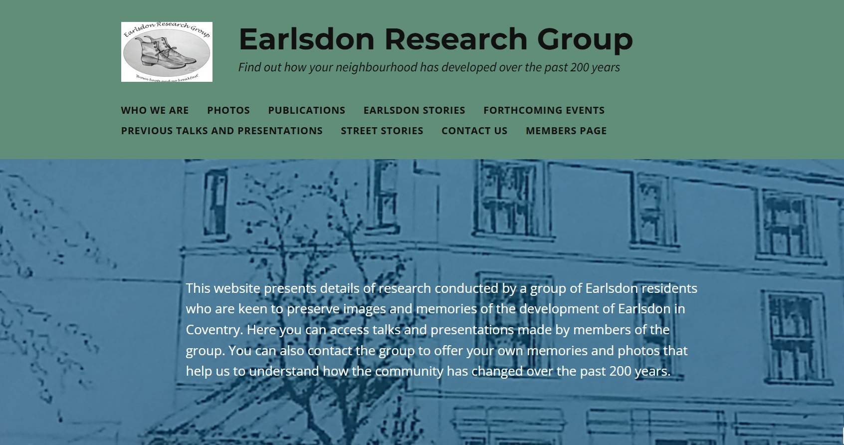
For more information about Earlsdon’s history, please visit https://earlsdonresearchgroup.org/

Slide 20
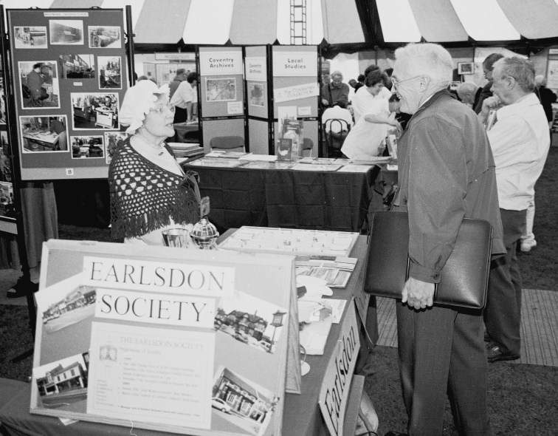
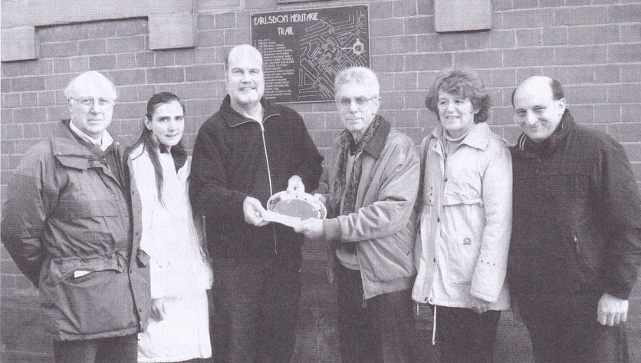
A Dedication to Two of Earlsdon’s History Pioneers
Mary Montes – who researched Earlsdon’s early documents and produced many publications about the estate’s history
Bill Dunn – who collected many of the first photographs of Earlsdon and took many of his own to document changes here over some forty years

