Slide 1
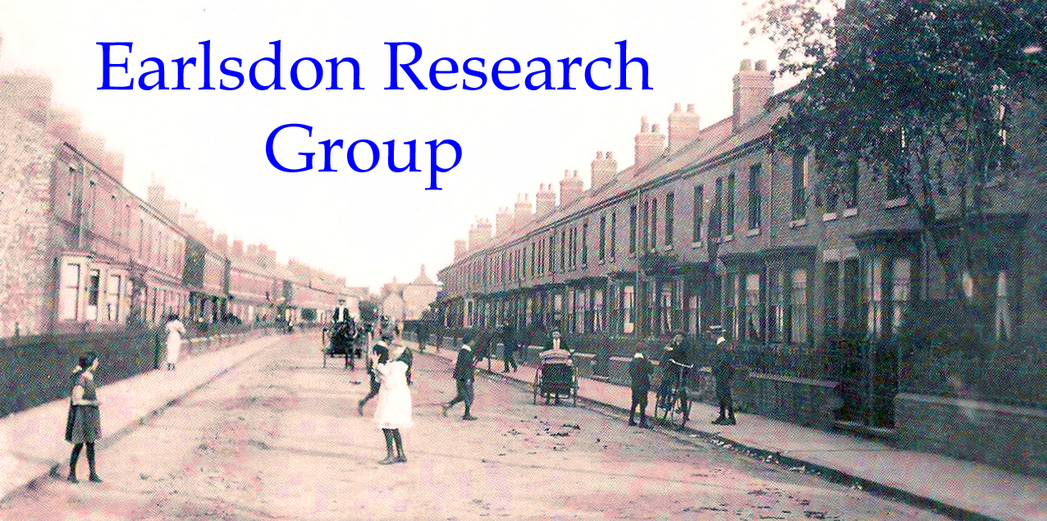
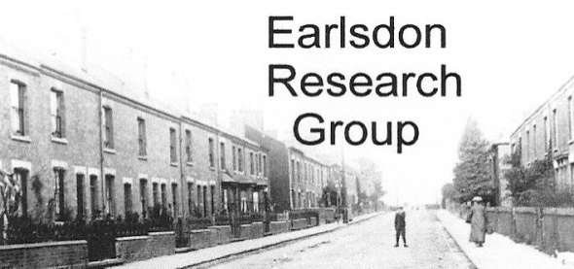
The development of Earlsdon’s Avenues

Slide 2
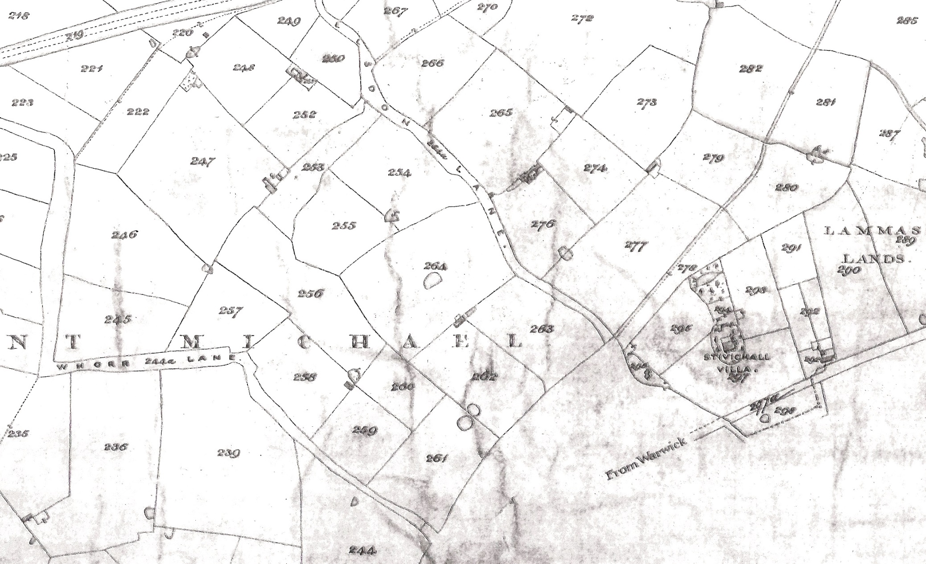
Tithe Map of 1847

Slide 3
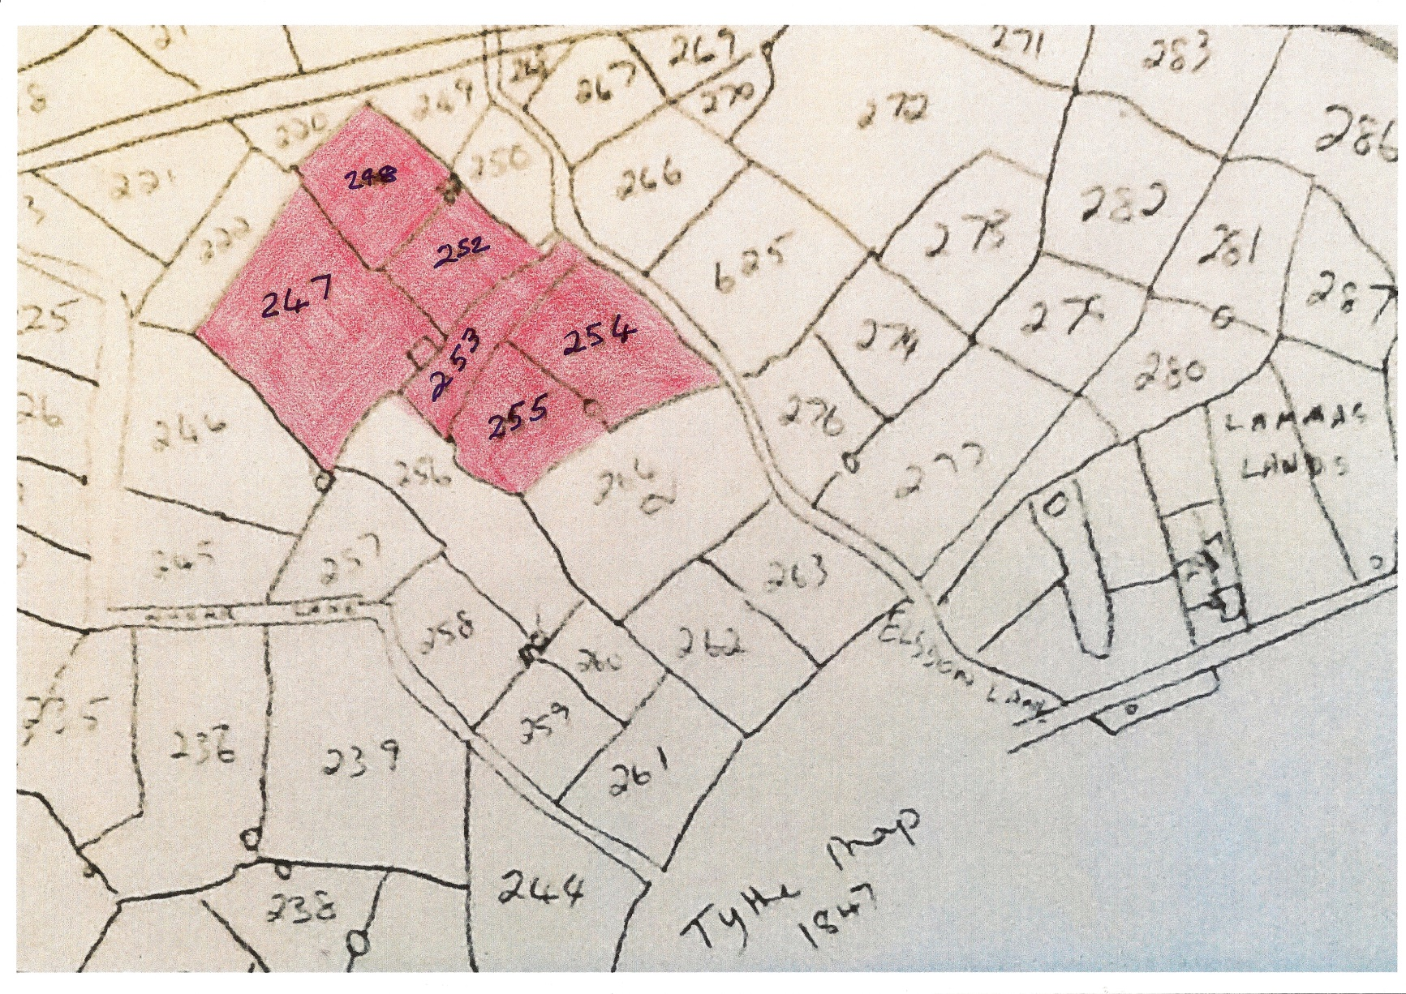
These fields became Earlsdon 8 Streets

Slide 4
Owned by William Pickering 1847
    247 Big Ground meadow
  248 Barn Close arable
  251 house, outbuildings
  yard and garden
  252 Home Close arable
  253 The Slang pasture
  254 Elsdon Lane Close meadow
  255 Far Close pasture

Slide 5
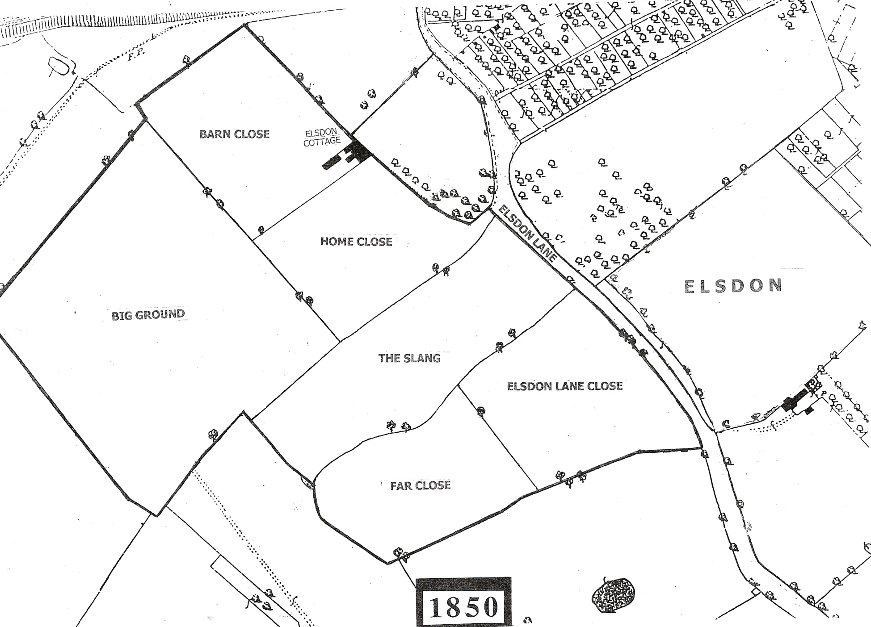

Slide 6
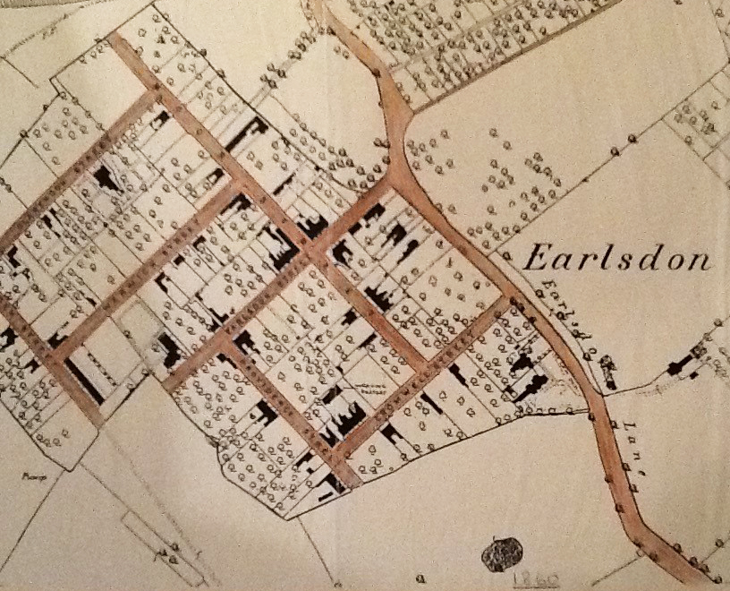
By 1860

Slide 7
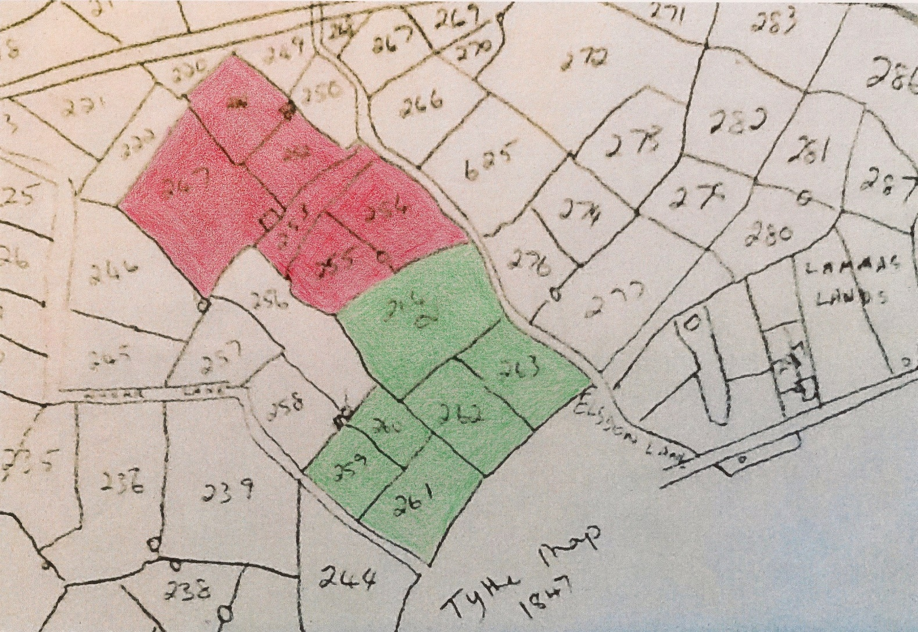
Became Styvechale Estate

Slide 8
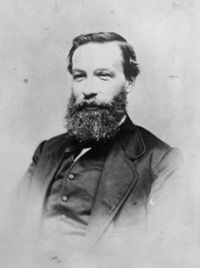
Thomas Stevens

Slide 9
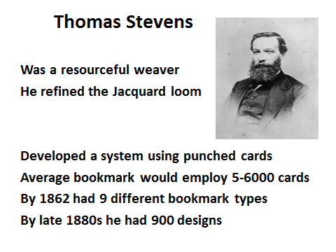

Slide 10
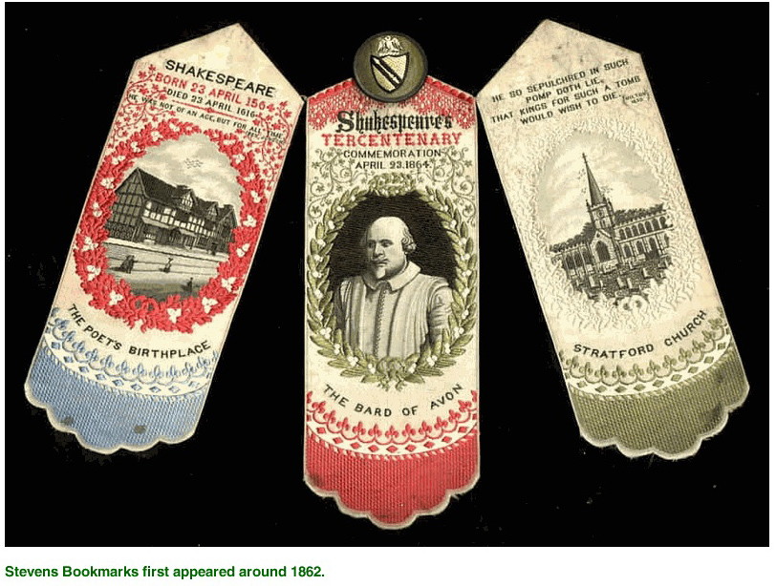

Slide 11
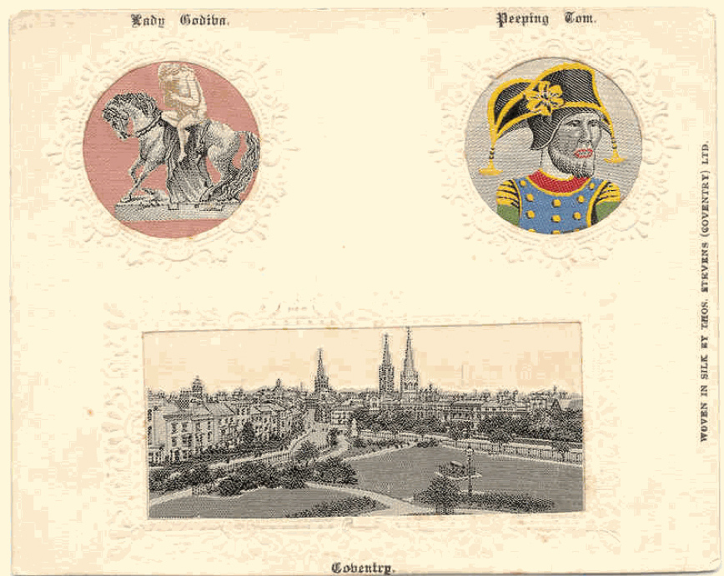
After 1892

Slide 12
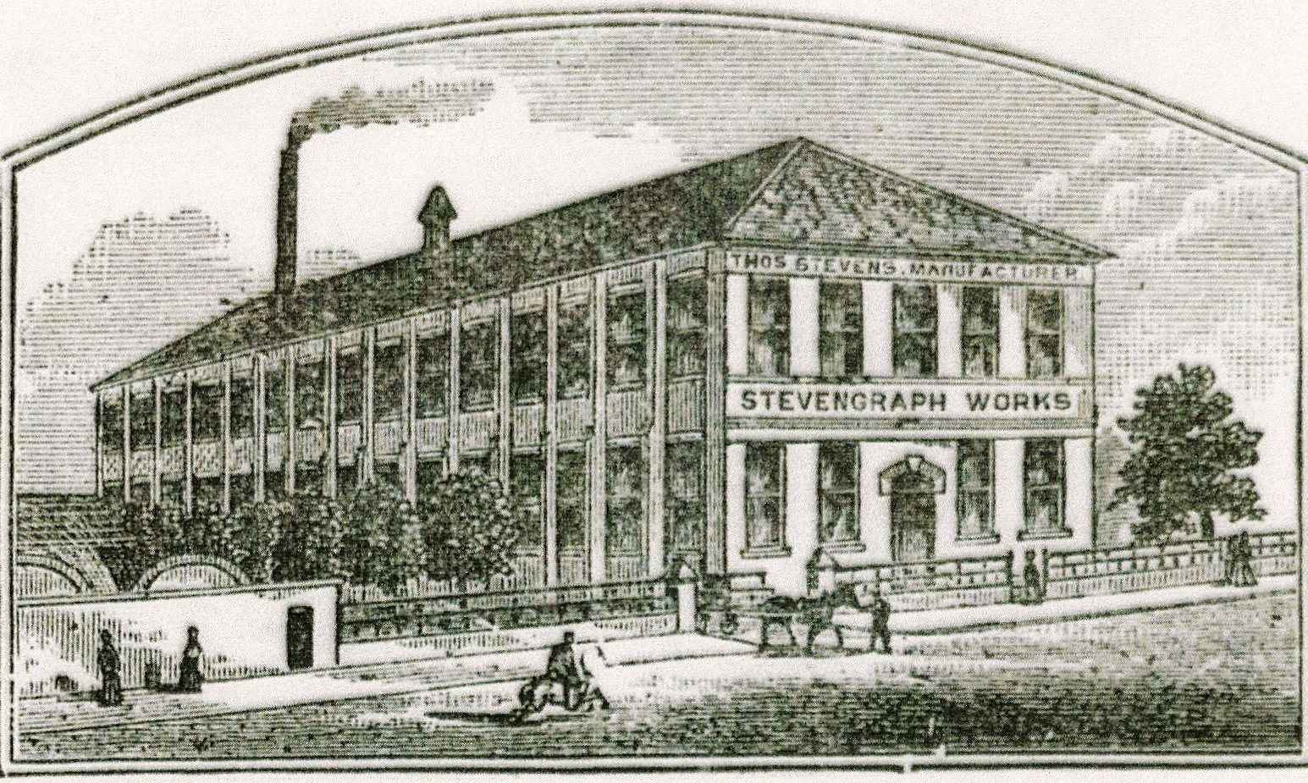
Stevengraph Works - Cox Street

Slide 13
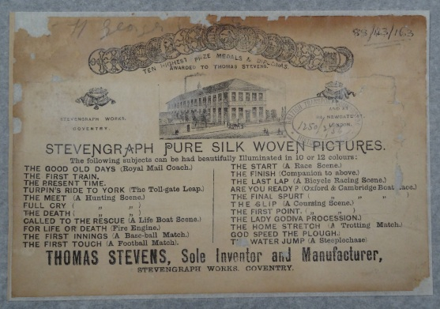

Slide 14
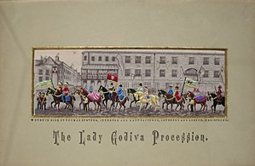

Slide 15
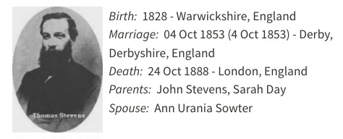
Thomas Stevens & Family
Lived at Holly Bank
On Elsdon Lane

Slide 16
Thomas moved to London
Thomas left Coventry for London in 1878 to look after the commercial side
His son Thomas Inger Stevens stayed on to become Production Director
When Thomas Inger died in 1908 it became a limited company

Slide 17
Thomas Inger Stevens
Lived at Holly Bank in Earlsdon Lane
- this Lane became Earlsdon Avenue
Thomas became chairman of :-
Earlsdon Syndicate who developed land in South West Earlsdon

Slide 18
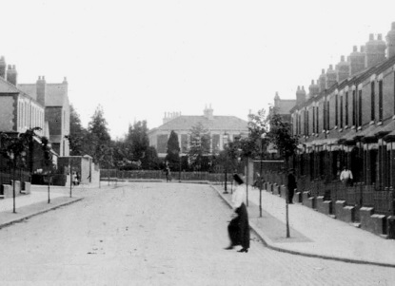
Holly Bank from Mayfield Road

Slide 19
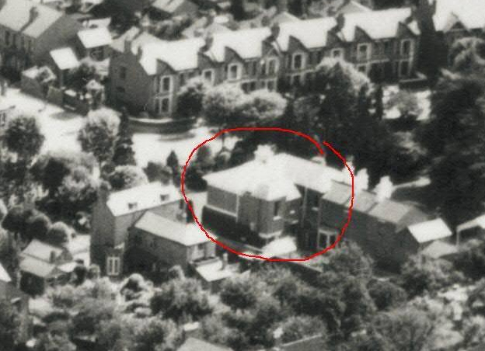
Holly Bank from the air

Slide 20
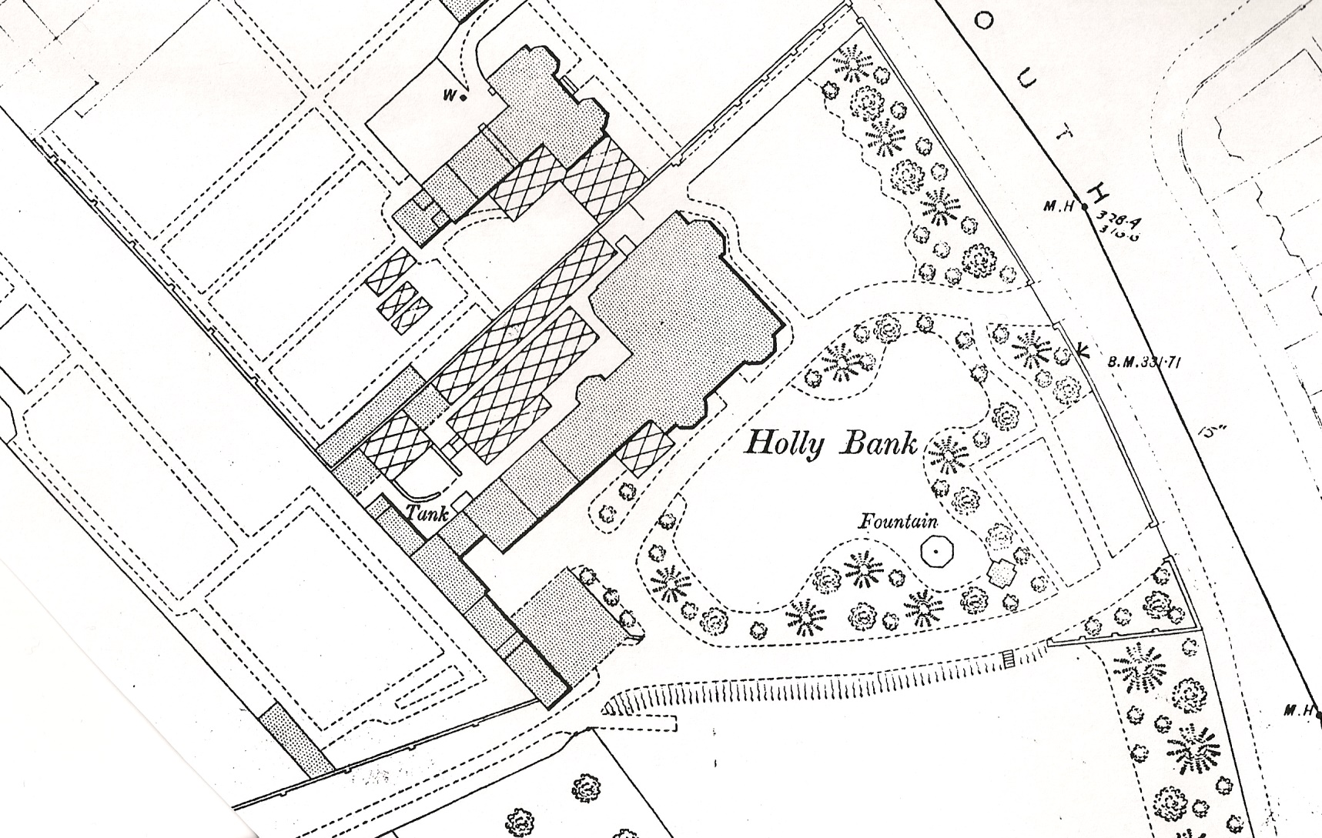
Holly Bank built in 1855

Slide 21
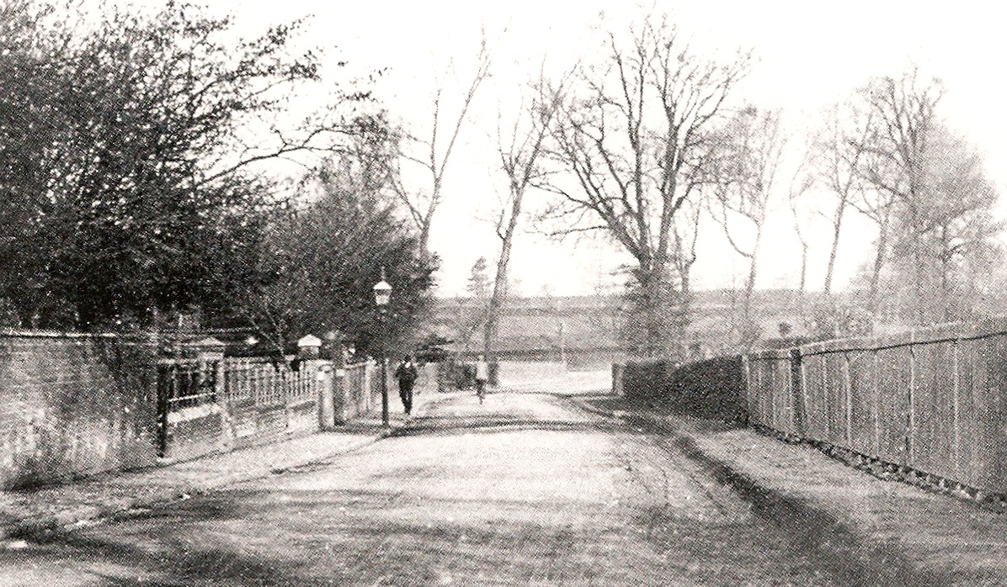
Earlsdon Lane c1890

Slide 22
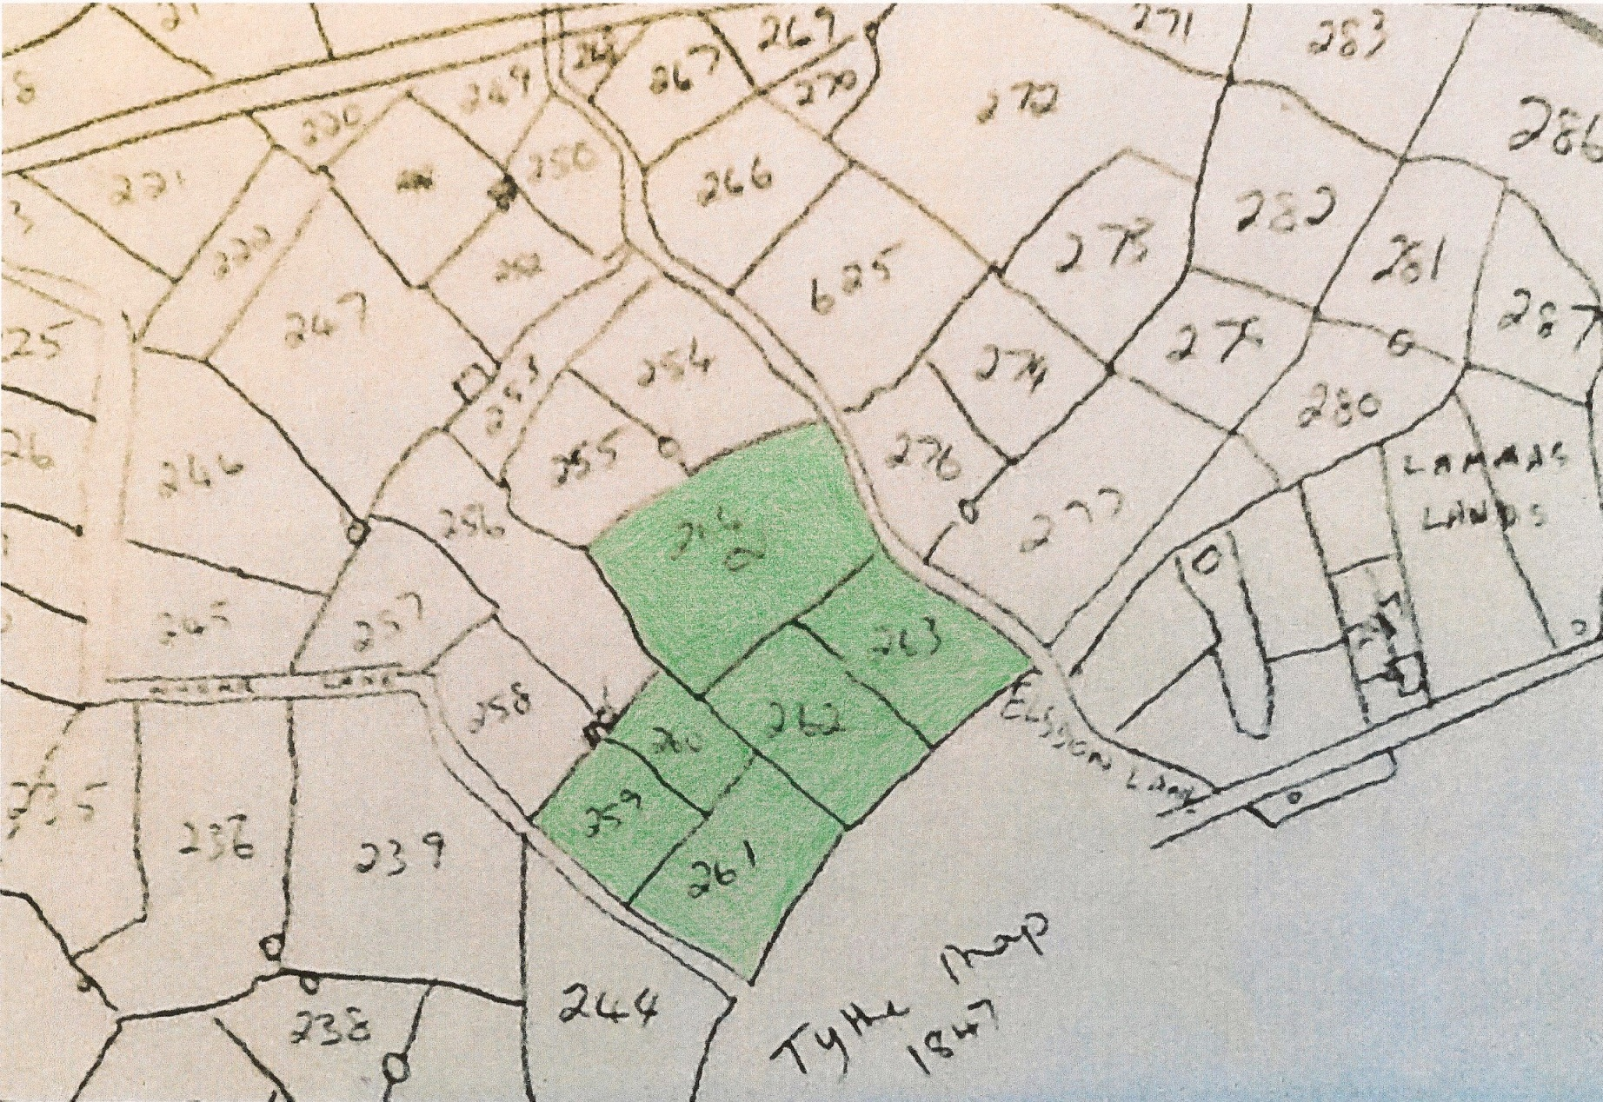
South West Earlsdon

Slide 23
Parcel of land where Earlsdon Ave. Warwick Ave. & Styvechale Ave. were built
Once it was part of the district of Asthill & Horwell (or Whorwell)
Whor Brook ran South from Hearsall Common to Canley Ford and Asthill stood to the East of it
In 1849 the land belonged to Anna Woodcock -when she died she left it to her son Charles

Slide 24
Will of Charles Woodcock 21st Jan 1875
Left 3 closes of grassland - about 3 acres with a barn occupied by William Welton
+ 3 closes of grassland of 20 acres occupied by Henry Whale
To his son George

Slide 25
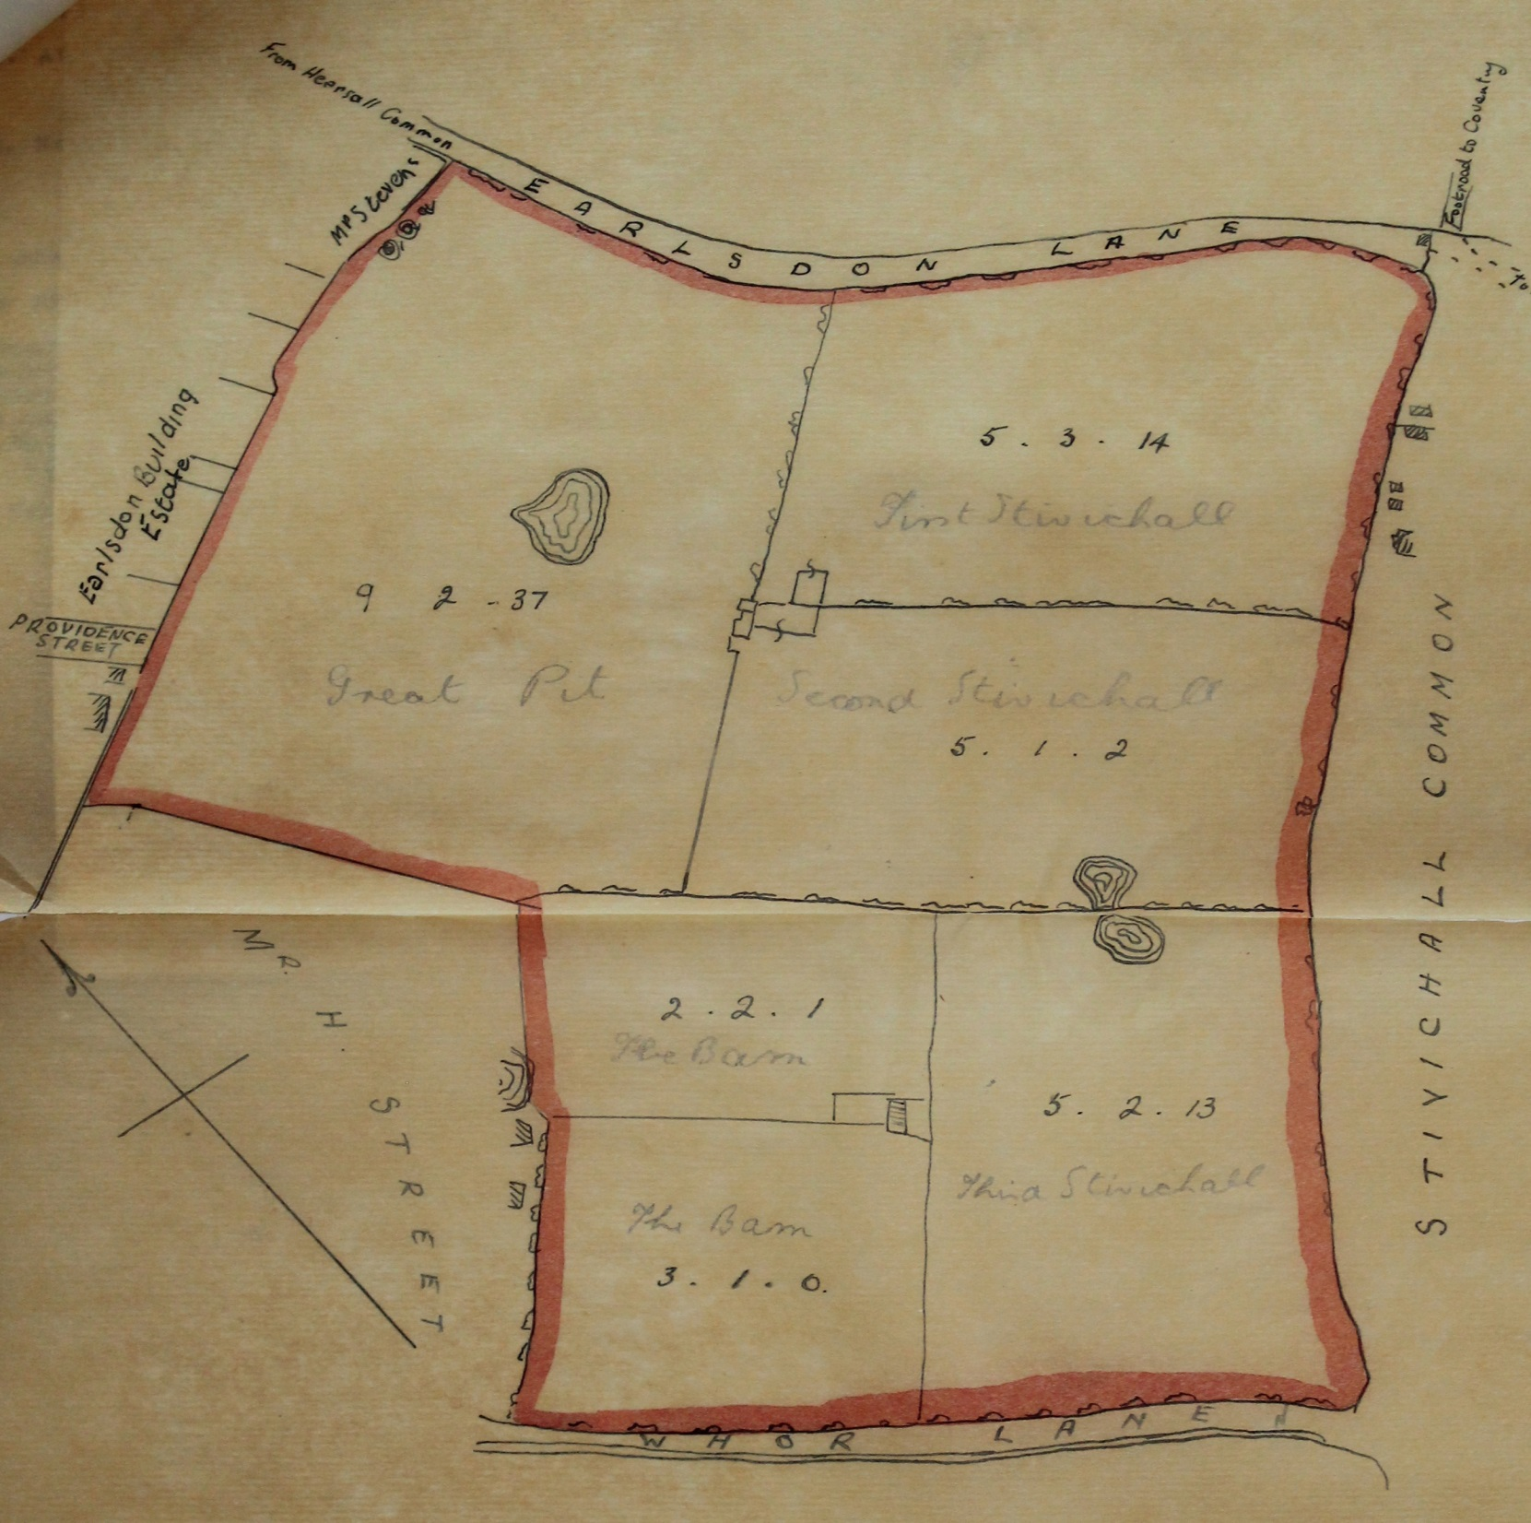

Slide 26
2nd April 1891
Sale of all six closes from George to James Whittingdale an auctioneer for the price of £4500
In 1893 James sold approx. 10 acres to Major Francis Hood Gregory

Slide 27
26th July 1897
Land was acquired for £6900 by :-
Earlsdon Syndicate
Thomas Smith of Aston
Frederick Warwick of Birmingham
Edward J Purnell of Coventry
Thomas I Stevens of Coventry

Slide 28
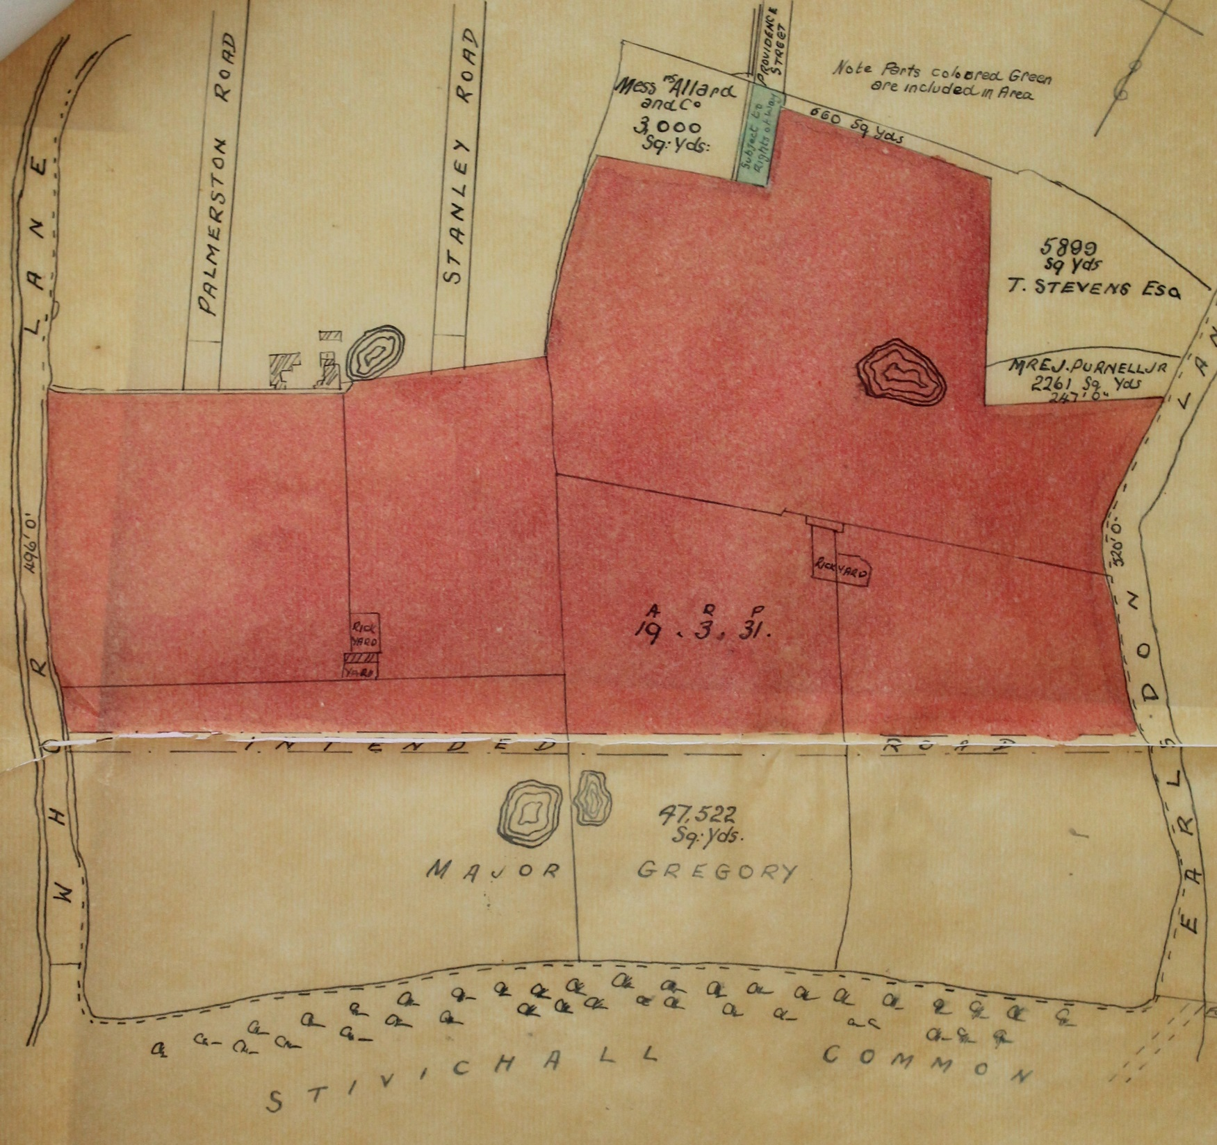

Slide 29
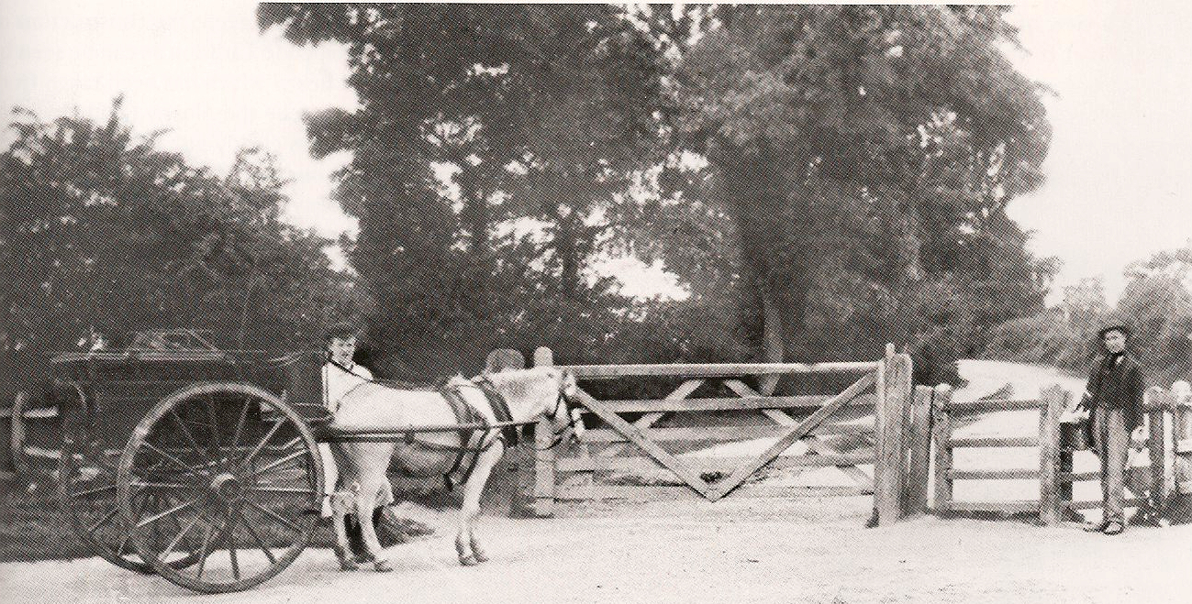
Entrance to Earlsdon Lane from Styvechale Common c1890

Slide 30
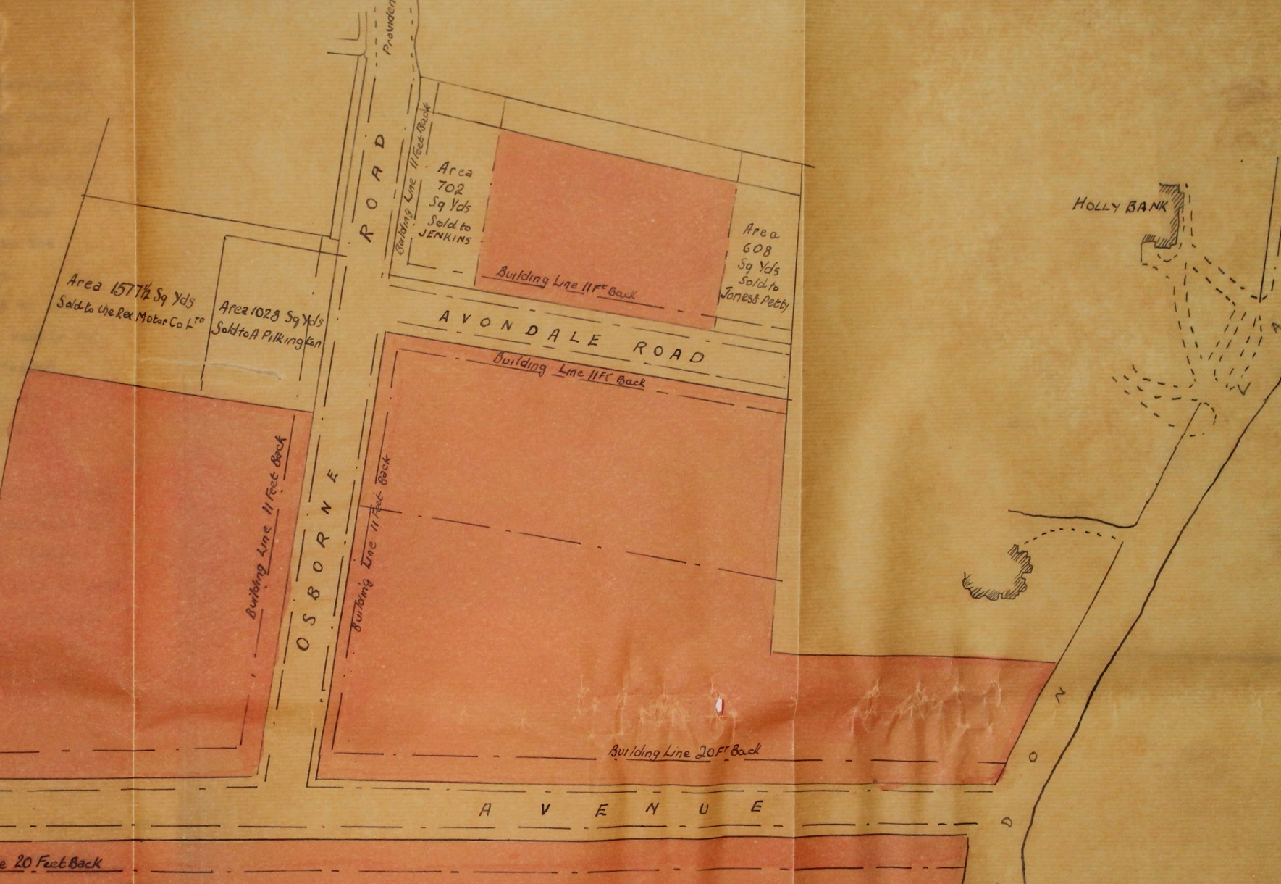
By 1901 both Styvechale Ave & Warwick Ave were in place

Slide 31
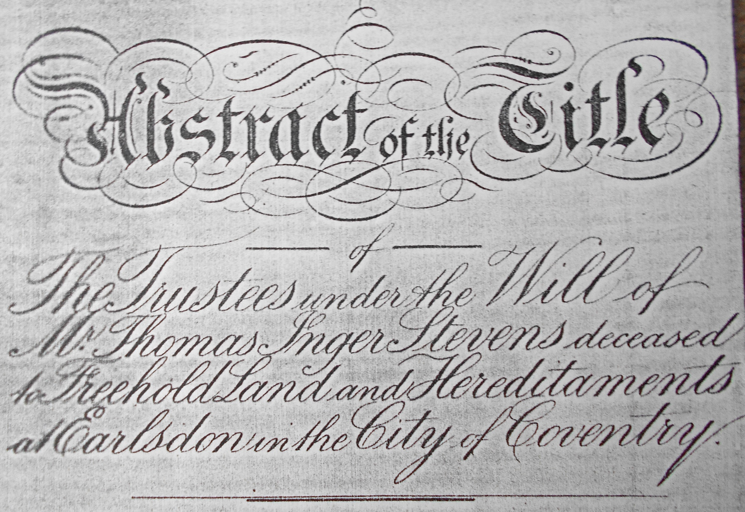
Thomas Inger Stevens died in 1908

Slide 32
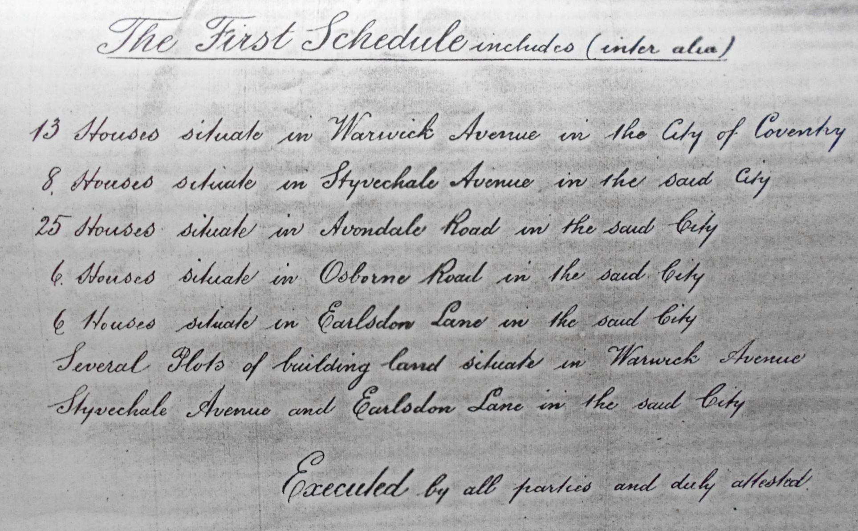
Part of his will - 58 Properties

Slide 33
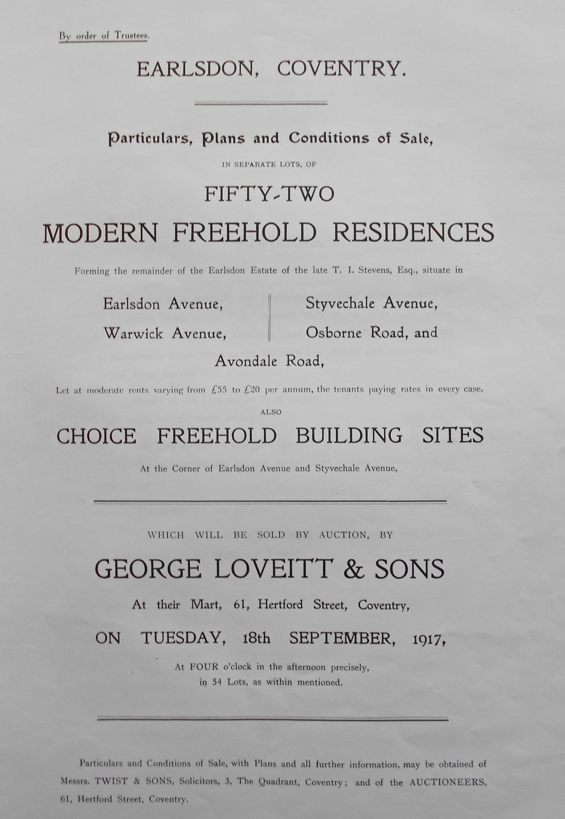

Slide 34
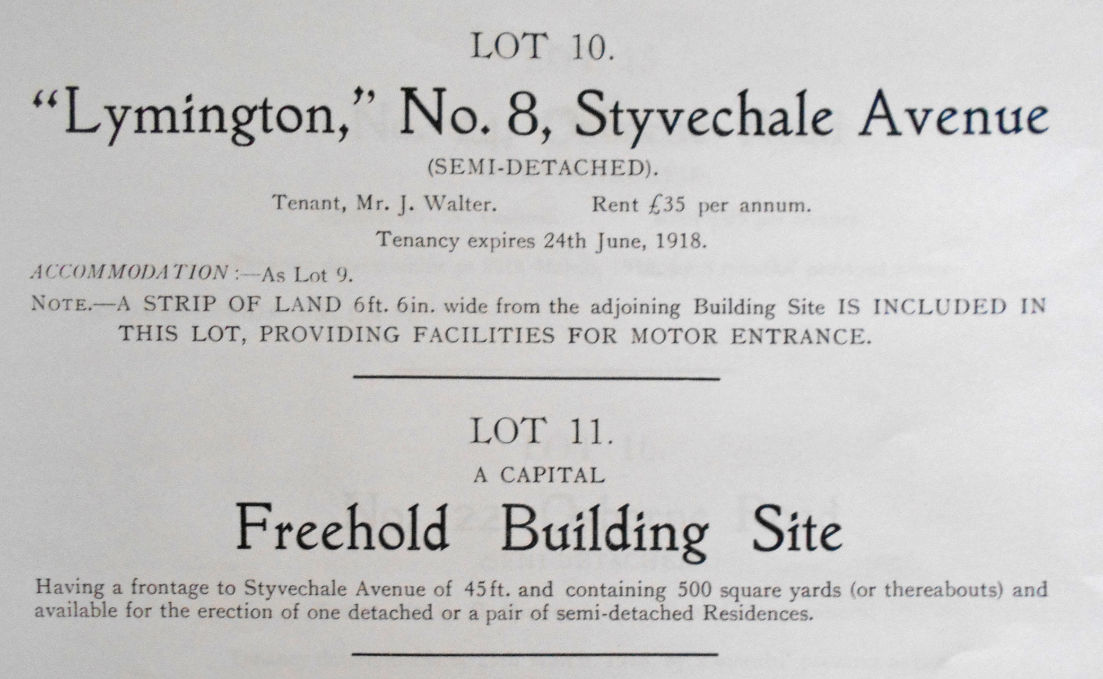

Slide 35
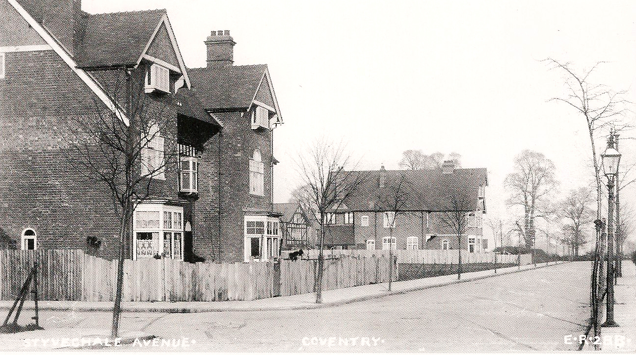
Styvechale Avenue c1907

Slide 36
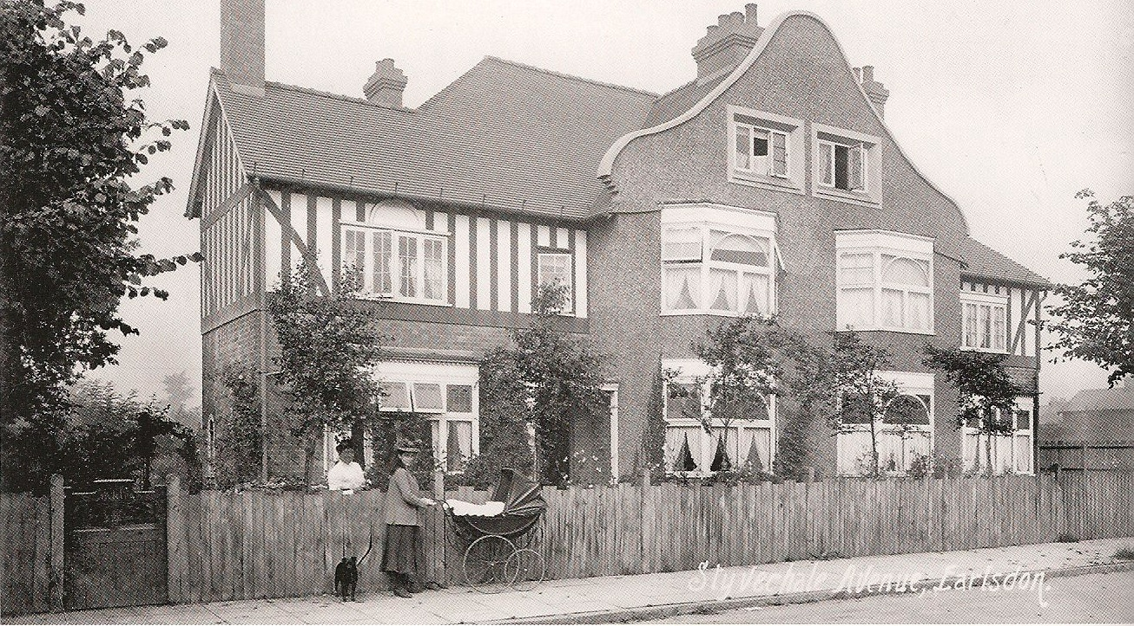
Styvechale Avenue c1908

Slide 37
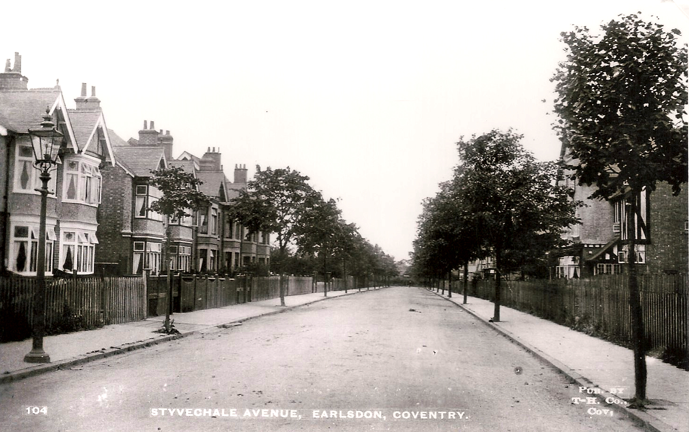
Styvechale Avenue c1913

Slide 38
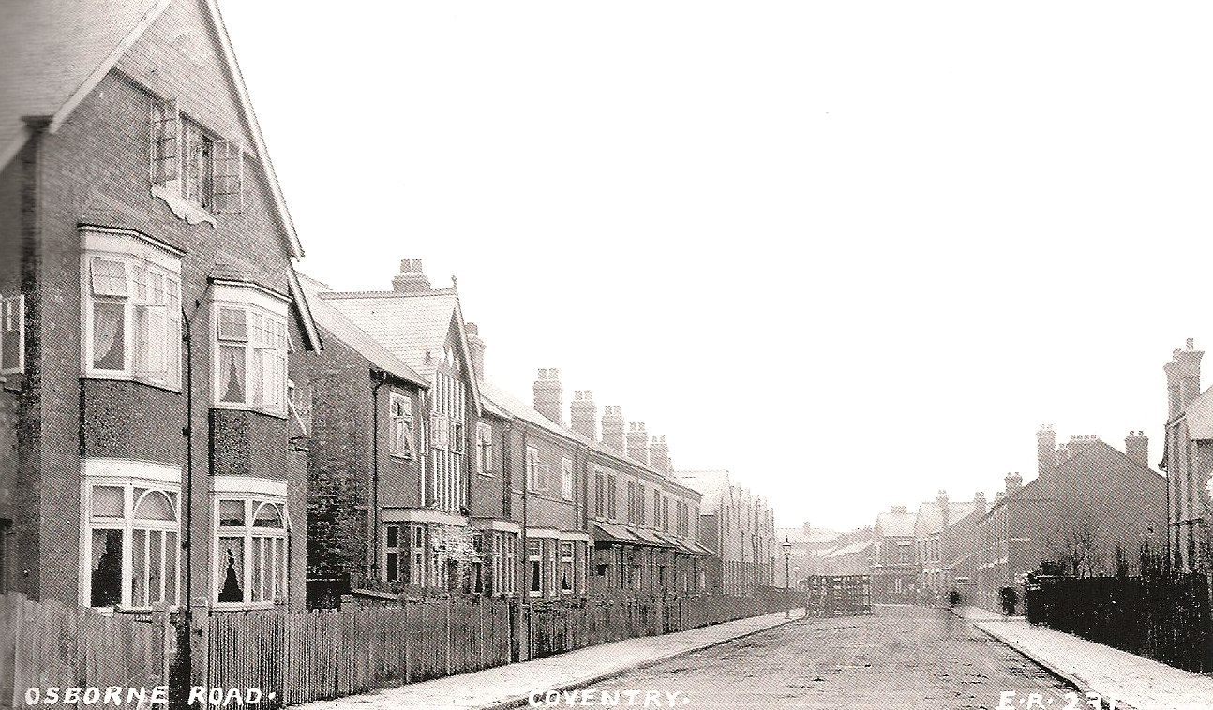
Osborne Road c1907

Slide 39
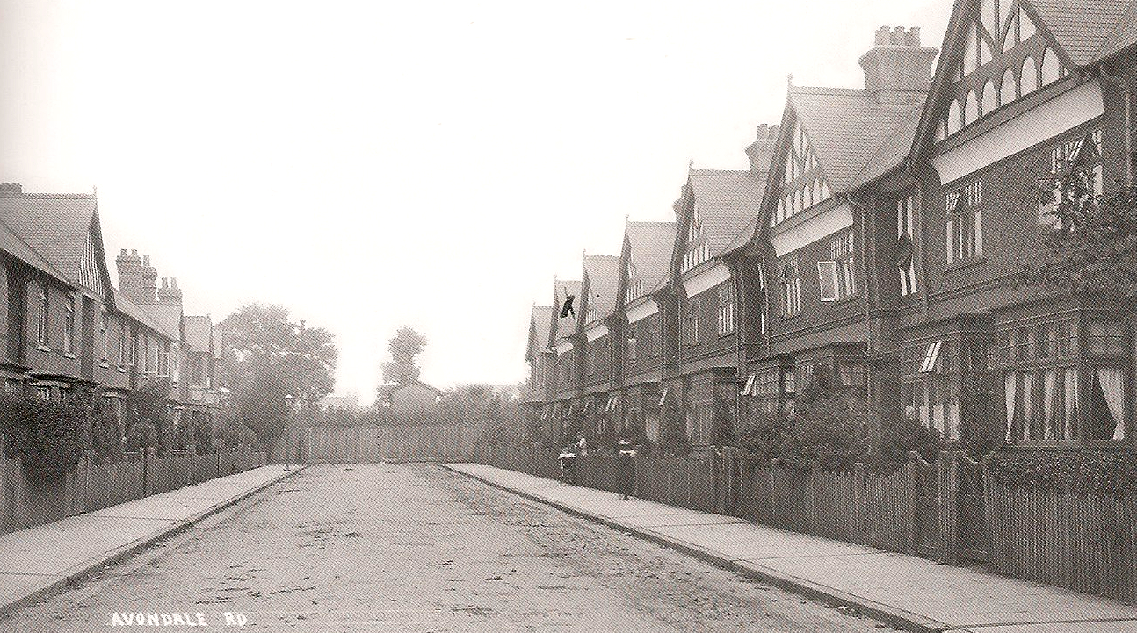
Avondale Road c1914

Slide 40
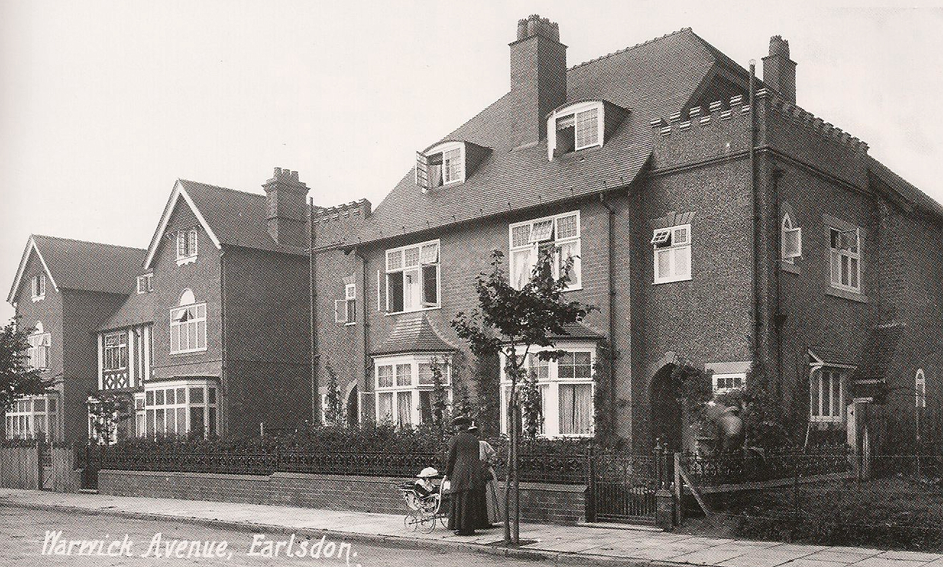
Warwick Avenue c1909

Slide 41
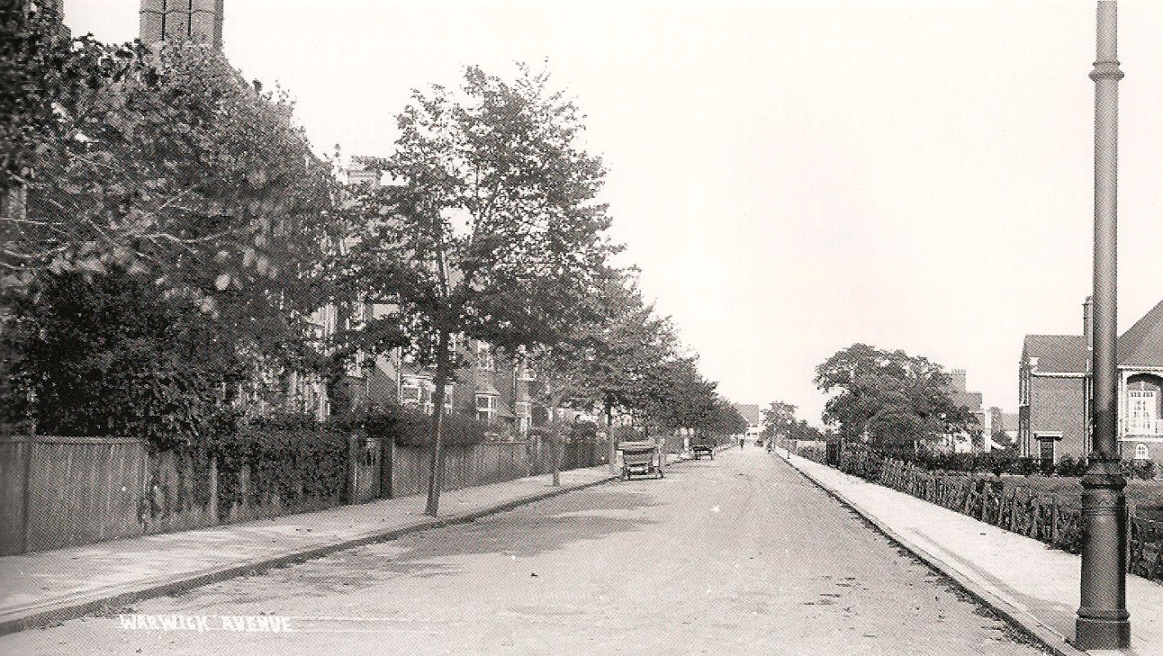
Warwick Avenue c1913

Slide 42
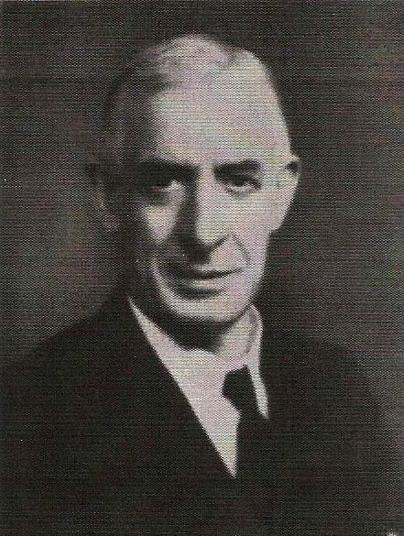
Lymington - No. 8 Styvechale Ave
Thomas Inger Stevens died in 1908
21st February 1918 the trustees of his will sold to Herbert Henry Harley

Slide 43
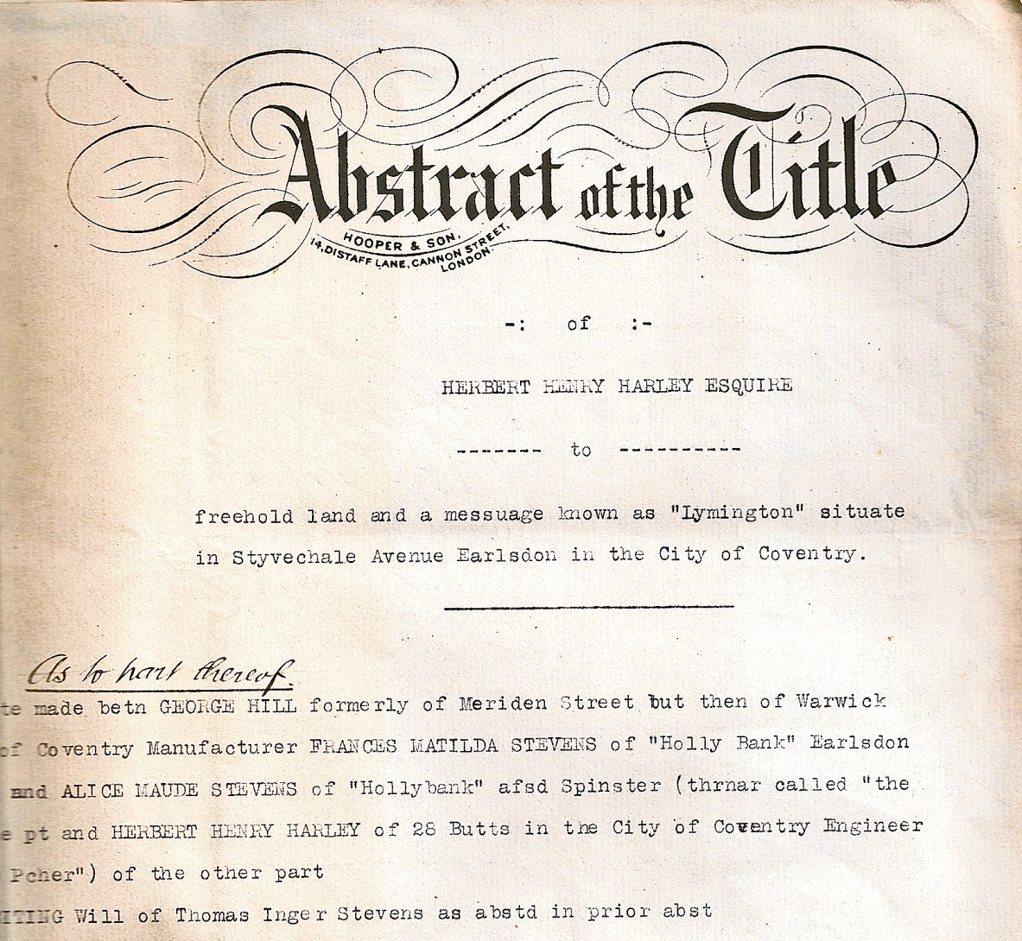

Slide 44
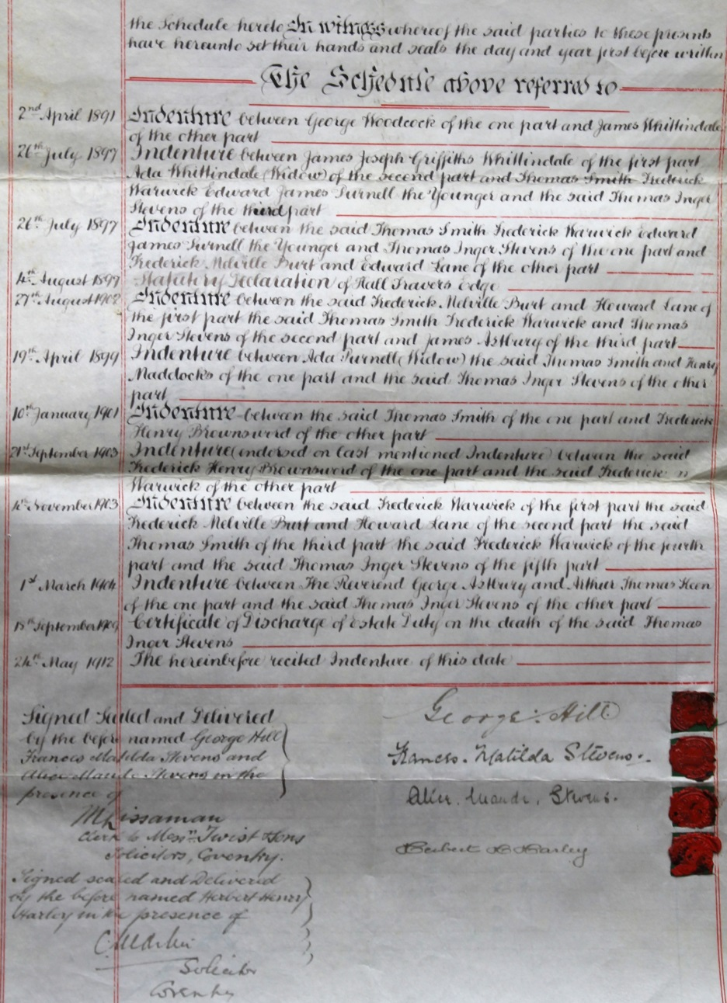
G.Woodcock 1891 thro’ H.Harley 1918

Slide 45
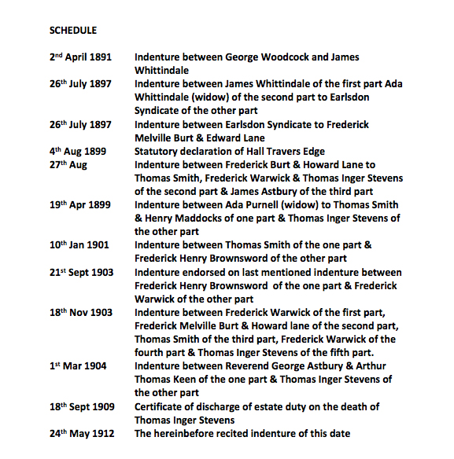

Slide 46
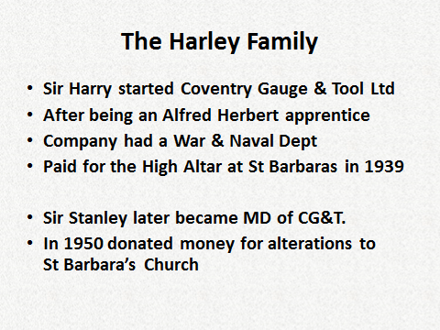

Slide 47
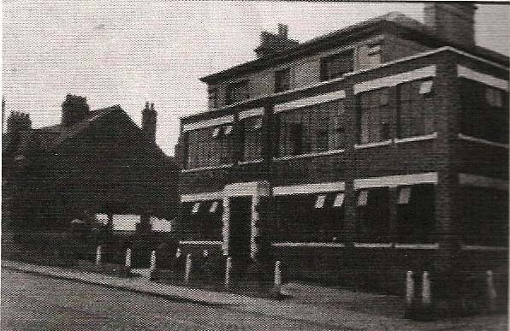
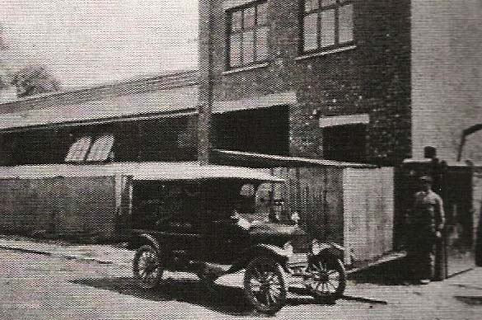
C.G.&T. Earlsdon St. & the company Model T Ford

Slide 48
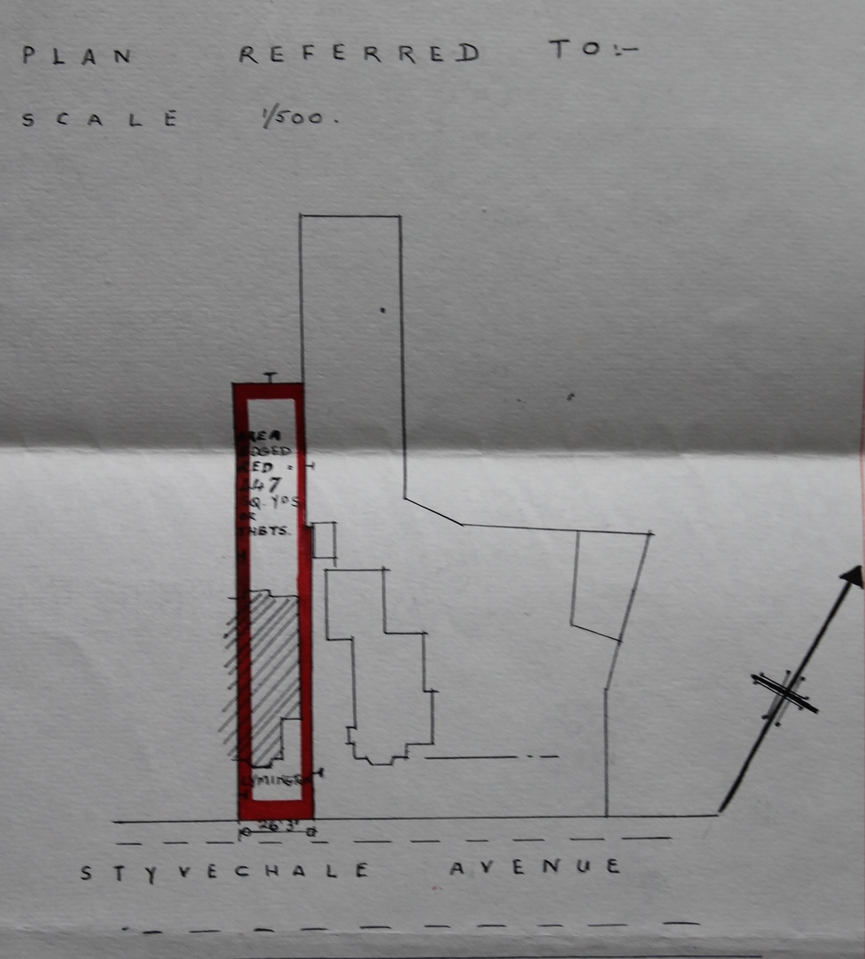
Plan of 8 Styvechale Avenue

Slide 49
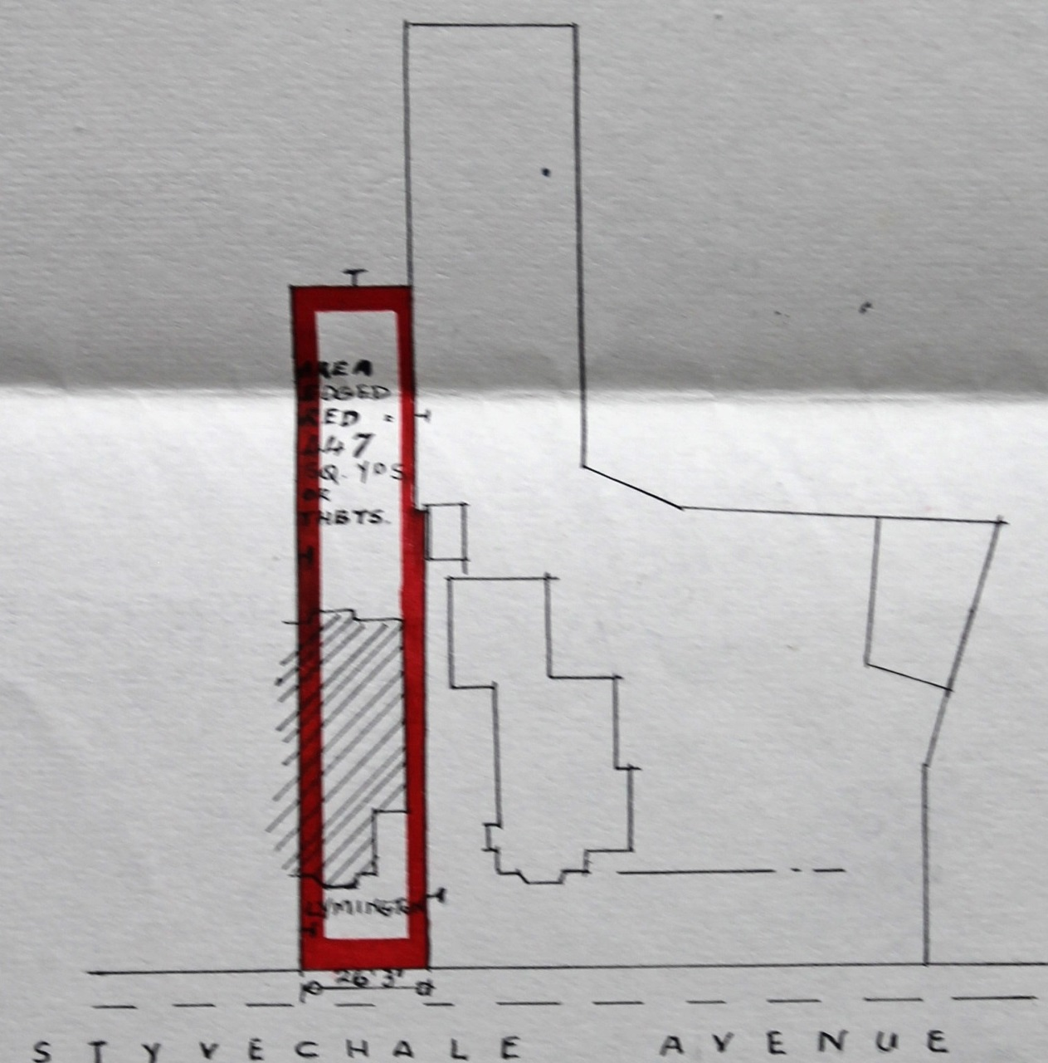
Area 447 sq yds Frontage 26ft 3ins

Slide 50
Number 8 Lymington
30/5/1924 Harry Harley to Thomas Couch
2/4/1930 F.G.Couch to Mrs M.B.Purvis
1/6/1937 M.B.Purvis to Mrs Lydia Harley
Lydia Harley was the wife of Harry !!

Slide 51
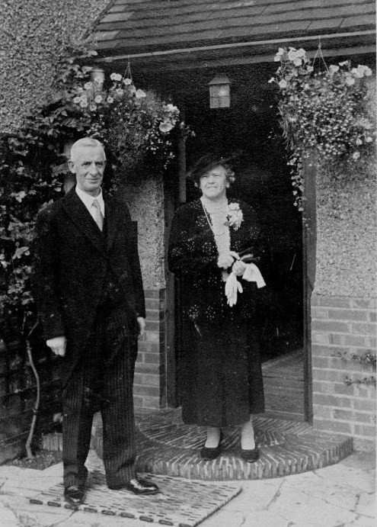
Harry & Lydia Harley

Slide 52
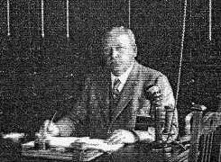
Number 8 Lymington – Contd.
30/05/1945 L.Harley sold to G.S. Hill
George Stanley Hill was one of the trustees of Thomas Inger Stevens’ will
He ran the Stevengraph Company from 1908 until 1932

Slide 53
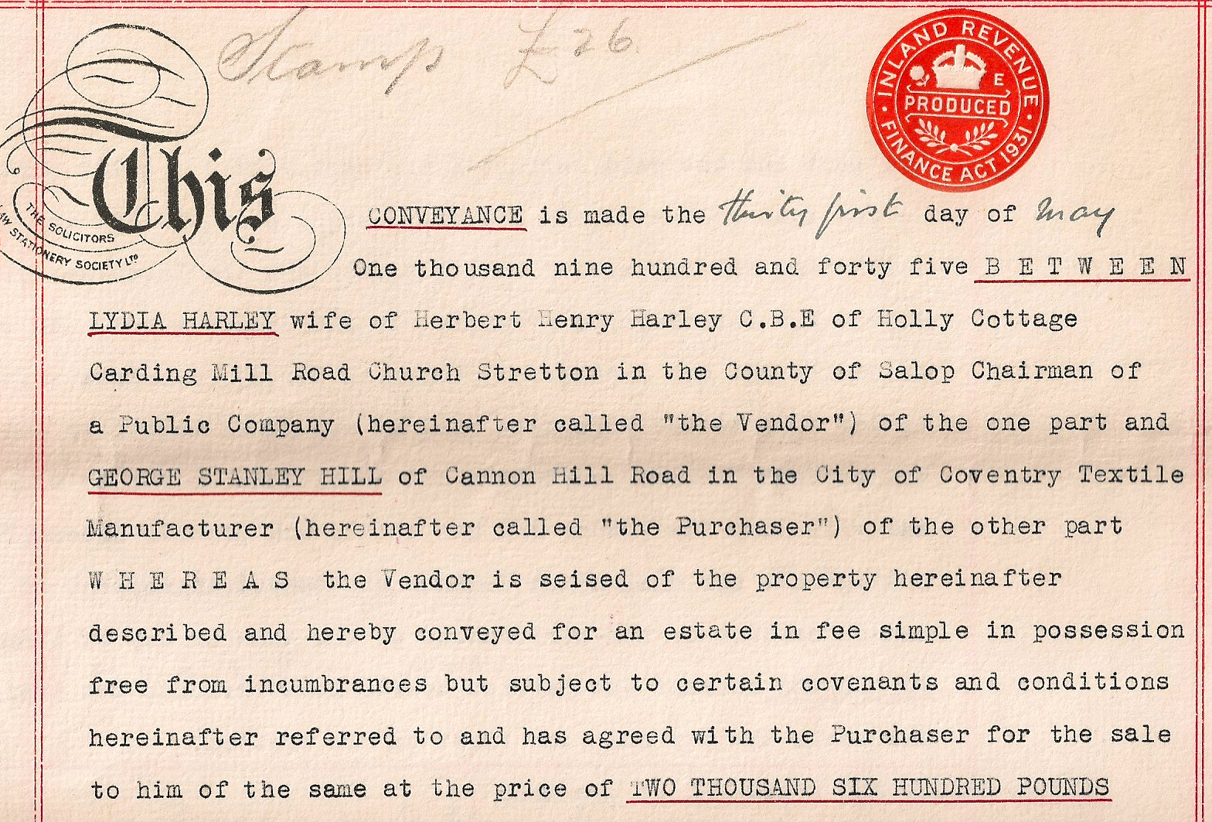

Slide 54
Sales of Lymington
H.Harley
T.Couch
M.Purvis
L.Harley
G.S.Hill

Slide 55
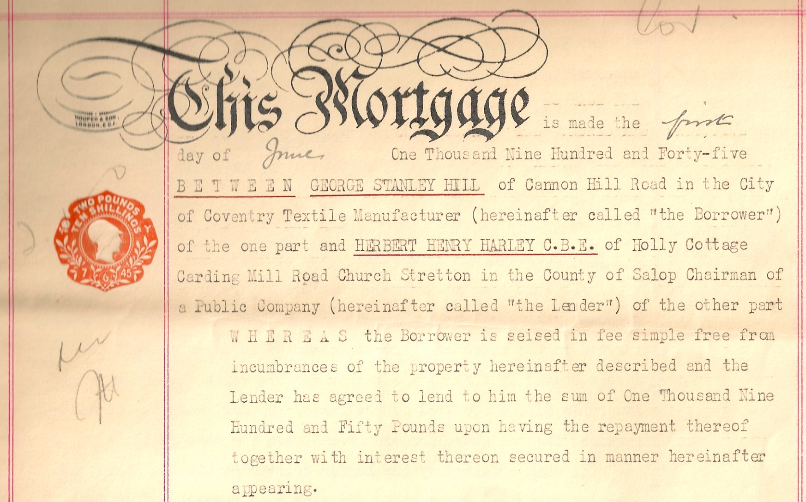

Slide 56
Number 8 Lymington - Contd.
22/4/1949 G.S.Hill to G.H.March
1/6/1964 Gordon March to wife Sheelagh
23/2/1977 S.March to Mr & Mrs Horton
24/1/1992 Title Deeds returned to :-
Roderick & Moya Horton

Slide 57
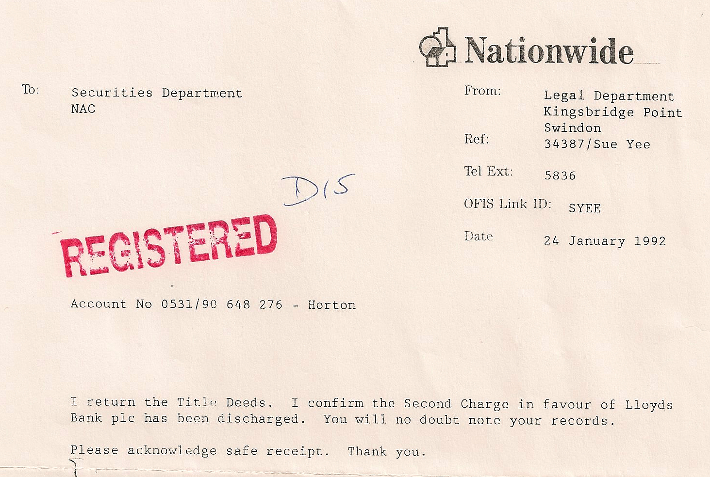

Slide 58
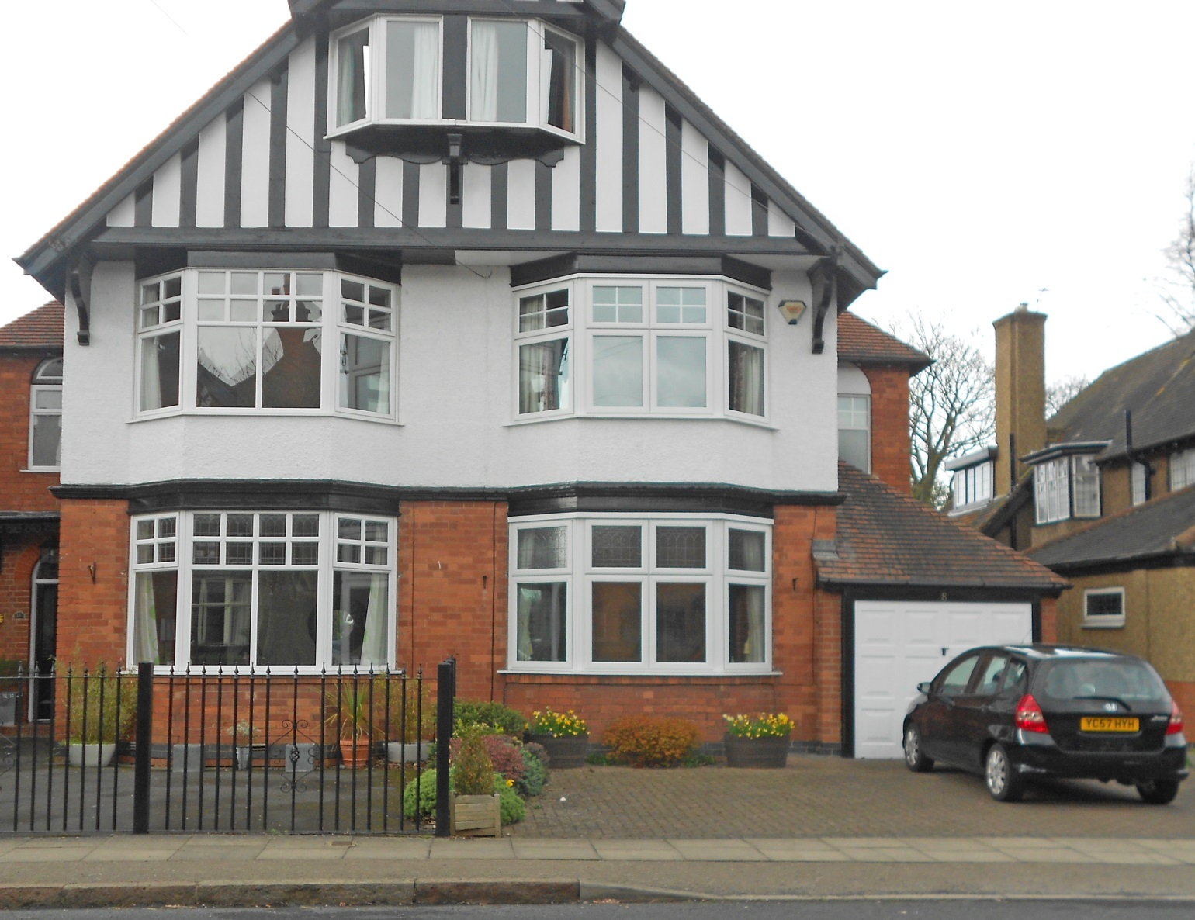
Lymington - Today

Slide 59

Area 515 sq yds Frontage 31 ft 3 ins

Slide 60


Grave of Lydia & Harry Harley

Slide 61

BillionGraves.com

Slide 62


Slide 63
WHY?
There are no graveyards in Earlsdon

Slide 64

Messrs Allard and Co.

Slide 65


Allard & Co was established in Coventry 1889 by F.W. Allard & George Pilkington to build cycles

Slide 66

First produced In 1899

Slide 67

Rex Motor Co. Ltd.

Slide 68


Slide 69
Rex Motor Manufacturing Co. Ltd Osborne Road Earlsdon
The company was formed in 1901 when Birmingham Motor Manuf. merged with Allard and Co.

Slide 70



Slide 71


Slide 72

Too small for car production – so focused on motorcycles

Slide 73

Formerly Rex Motor Co.

Slide 74


Also in Osborne Road

Slide 75



Production started 1899

Slide 76

Founder of Triumph in 1896 - Siegfried Bettmann

Slide 77



Coventry Bicycles Ltd. also made Triumph Cycles from 1936

Slide 78
The End
Acknowledgements :
Albert Smith & David Fry : The Coventry we have lost
Kevin Noble : Earlsdon Online

Slide 79


Slide 80


Slide 81


Slide 82


